Slide 1
Los Osos Offset Program Amendments, Title 8 and Title 19 – Public Review Draft Overview
December 6, 2023
Notes:
Thank you and good Afternoon. My name is Kip Morais, with County Planning. I will be presenting the three action items before you today.

Slide 2
Background
June 30, 2023 – Maddaus Water Management, Inc. completes Title 19 Los Osos Water Offset Program audit (i.e., The Los Osos Water Offset Study)
October 17, 2023 – County BOS requested draft amendments to Title 19
November 27, 2023 – Public Review Draft of Los Osos Offset Program amendments shared
December 31, 2023 – Public comment due on Public Review Draft
February 27, 2024 – County BOS Hearing on Draft Los Osos Offset Program amendments

Slide 3
Summary of Amendments
Notes:
Based on the results of the Los Osos Offset Study completed in June of this year and also public comment that has been received throughout this process by members of the public. The public review draft package that was published on November 27 contains the public questions and comments that were received during the August BMC and Los Osos Community Advisory Council meetings.

Slide 4
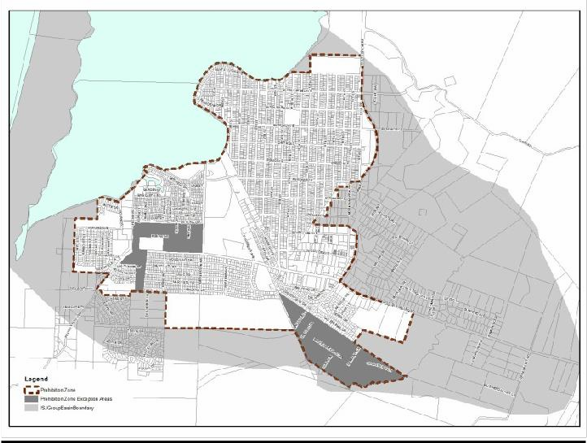
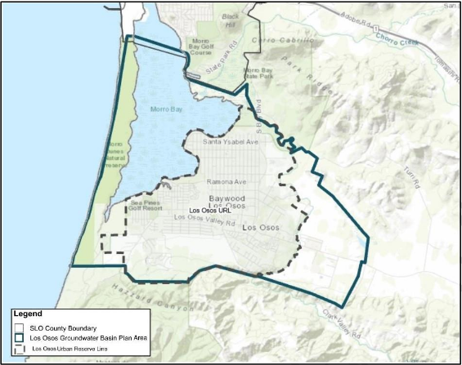
Amendments to Title 8 Retrofit-Upon-Sale and Title 19 Retrofit-to-Build
Program Map
Existing Proposed

Slide 5
Amendments to Title 8 Retrofit-Upon-Sale and Title 19 Retrofit-to-Build
Program Map
New fixture flow requirements:
Toilets: effective flush rate of 1.0 gpf
Showerheads: 1.5 gpm

Slide 6
Amendments to Title 19 Retrofit-to-Build
Prohibition Zone/Los Osos Sewer Service Area inclusion
Amount of Total Water Savings required
Mobile Homes/Multi-Family and Single Family dwellings
Dependent upon: water source and parcel size
Program implementation
Staff to conduct post-installation inspections at random
Department to update the total water savings requirement every 5 years using the method established in the Los Osos Offset Study
Department to conduct a pilot program to test an outdoor water conservation program
Requirements are in the program applications
Calculated savings
Hot water recirculation systems
Clothes washing machine assumptions
Notes:
- The ordinance was amended around the time that the sewer was being constructed to restrict bathroom retrofits to only homes outside of the PZ. At that time, connection to the sewer required that homes update their bathroom fixtures to the current flow requirements in the ordinance. The Offset Study revealed that because it has been almost 8 years since the sewer came online, there is potential to install more efficient bathroom fixtures.
- Total offset or water savings required has been changed to be dependent upon water source (i.e., water purveyor or self-sourced) and parcel size. The requirements have also been changed to group the Mobile Homes and Multi-Family home requirements, based on the development of the requirements.
- Changes to program implementation:
- staff will conduct post-installation inspections at random to verify installations have been made
- the average usage rates and total water savings requirement will be updated every 5 years
- the Dept will conduct a pilot program to test an outdoor water conservation program
- the tables have been removed from the ordinance and are placed in the T19 application
- calculated water savings
- hot water recirc systems require more involvement to calculate savings
- adapted the clothes washing machine assumptions to reflect the most recent RECS survey
(based on climate, at 203 loads/year) the previous assumption was over 300 loads/year based on nationwide EPA assumptions

