Slide 1


WELCOME!
MHSA Advisory Committee (MAC)
Tuesday, June 26, 2018
Veterans Hall, San Luis Obispo
4:00pm – 5:30pm

Slide 2
Agenda
Welcome, Introductions, and Goals for meeting
Frank Warren, SLOBHD (Division Manager and County MHSA Coordinator)
CSS Work Plan Review & Updates
CSU/MHET Updates
PEI Work Plan Review & Updates
Nestor Veloz-Passalacqua, SLOBHD (ASO II)
INN Work Plan Review & Updates
New round: Planning for 19-20
Fiscal Update
Briana Hansen, SLOBHD (Accountant III)
Old Business
New Business for 2018-19
Next Meetings: 8/28; 10/30; 12/18
Conclusion

Slide 3

Overview
The MHSA provides San Luis Obispo County:
Funding, personnel, and other resources
Supportive programs for underserved populations
Best practices and innovative approaches
Prevention, early intervention, treatment, and recovery
Community partnerships and stakeholder engagement
Notes:
We are presenting the Annual Update as part of a new process which moves the approval of MHSA plans to the County level.
The MHSA was designed to move counties forward in delivering services for the underserved mentally ill, and build the capacity of the community at large

Slide 4
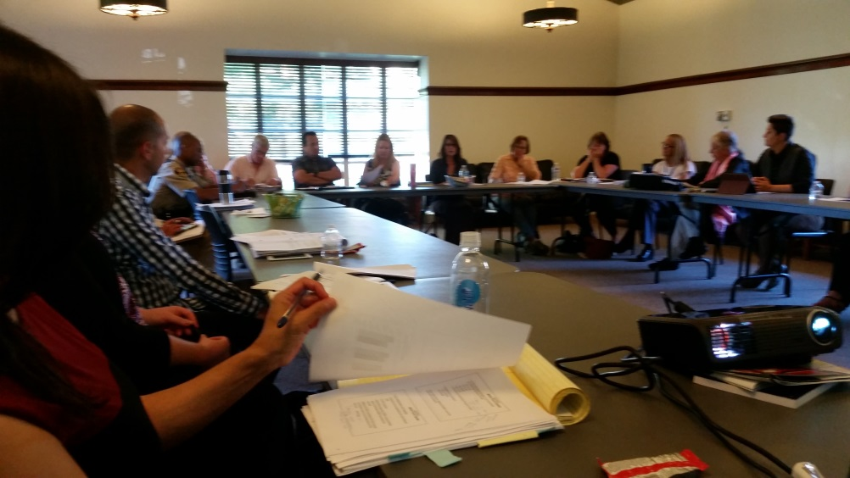
Introductions
MHSA Advisory Committee
MHSA Advisory Committee Introductions
Staff Introductions

Slide 5
Goals/Objectives
This is a somewhat informal meeting with all attendees welcome to comment, ask questions, make suggestions, etc.
MHSA planning requires stakeholder involvement to guide and advise plans.
Today’s meeting will update the MHSA oversight group (including original and new members) as to the implementation of the most current work plan.
We will also provide information on work plan changes, and introduce new funding initiatives, for discussion and approval.
We will use consensus-based decision making.

Slide 6
CSS Work Plan Review
Community Services and Supports (CSS)
Child & Youth Full Service Partnership(SLOBHD & FCN)
Transitional Age Youth FSP (SLOBHD & FCN)
Adult FSP (TMHA & SLOBHD)
Older Adult FSP (Wilshire CS & SLOBHD)
Client & Family Wellness (TMHA, CAPSLO & SLOBHD)
Latino Outreach Program (SLOBHD)
Enhanced Crisis & Aftercare (Sierra Wellness & SLOBHD)
CSU/MHET Presentation
Schools and Family Empowerment (SLOBHD & CAPSLO)
Forensic Mental Health Services (TMHA & SLOBHD)

Slide 7
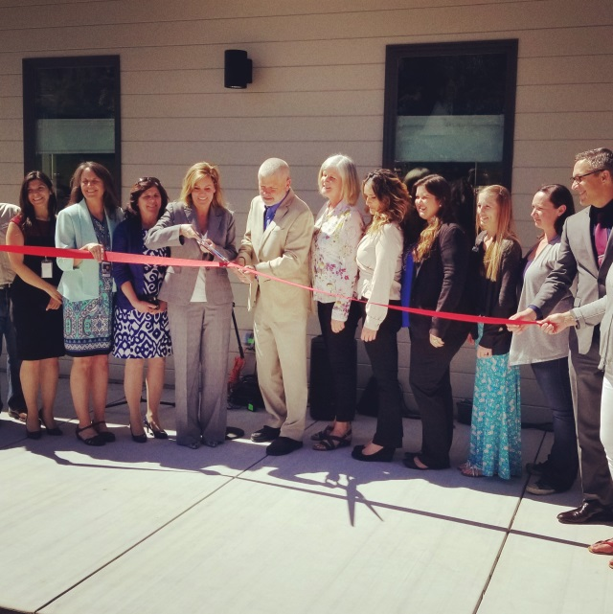
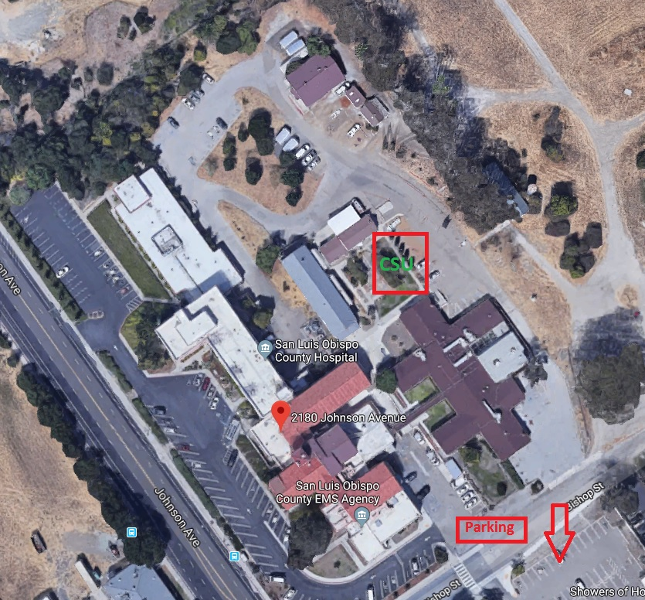
CSS Work Plan Review
Crisis Stabilization Unit (CSU)
Unit opened on 4/1!

Slide 8
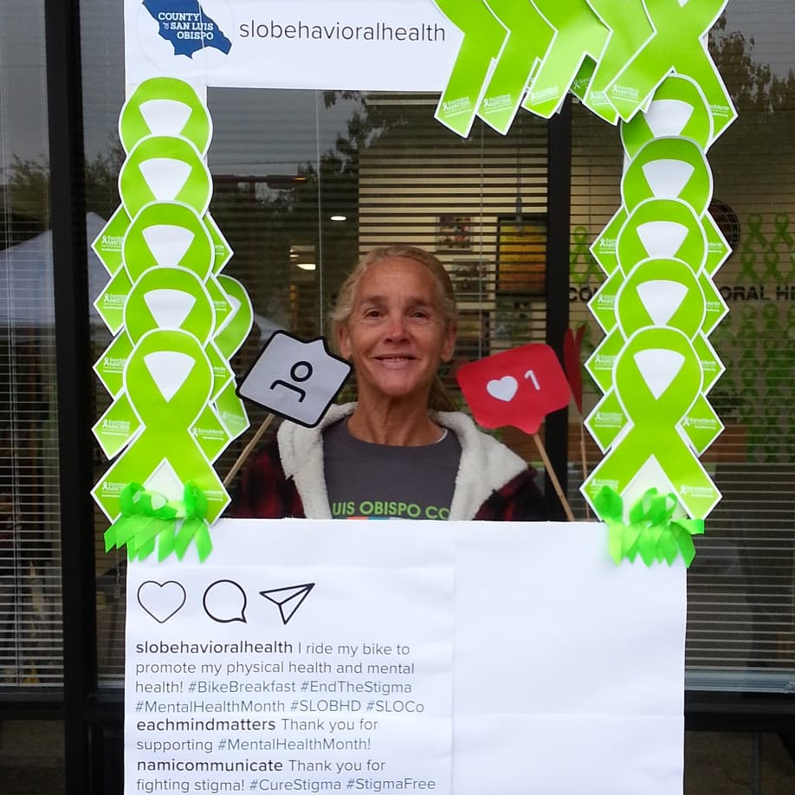

Prevention & early intervention (PEI)
STAKEHOLDER MEETING
june 26, 2018

Slide 9

Prevention & early intervention (pei)
WORK PLAN I
Prevention Program
1.1 Positive Development
1.2 Family Education, Training, and Support
1.3 Middle School Comprehensive Program
1.4 In-Home Parent Educator
1.5 Cuesta College Successful Launch

Slide 10
Prevention & early intervention (pei)
WORK PLAN II
Early Intervention Program
2.1 Community Based Therapeutic Services
2.2 Integrated Community Wellness
2.3 Young Adult Counseling
WORK PLAN III
Outreach for Increasing Recognition of Early Signs of Mental Illness
3.1 Perinatal Mood Anxiety Disorder (PMAD)

Slide 11
Prevention & early intervention (pei)
WORK PLAN IV
Access and Linkage to Treatment Program
4.1 Older Adults Mental Health Initiative
WORK PLAN V
Stigma and Discrimination Reduction Program
5.1 Social Marketing Strategy – Community Outreach & Engagement
5.2 College Wellness Program

Slide 12
Prevention & early intervention (pei)
WORK PLAN VI
Improve Timely Access to Services for Underserved Populations Program
6.1 Veterans Outreach Program
WORK PLAN VII
Suicide Prevention Program
7.1 Suicide Prevention Coordination/Coordinator

Slide 13
Prevention & early intervention (pei)
LGBTQ NEEDS ASSESSMENT – Contract FY17-18
Assess mental health, wellness, and related experiences in a sample of LGBTQ Identified people living the County.
Phase I: develop and provide a quantitative mental health and service utilization assessment.
Phase II: proctor qualitative focus groups to be conducted with specific sub-populations (LGBTQ youth, adults/older adults, transgender and gender non-binary individuals, and participants with mental illness experience)
Results and report to be provided by the end of this calendar year

Slide 14
INN Work Plan Review
INNovation
COLEGA
Late Life Empowerment & Affirmation Project
Transition Assistance & Relapse Prevention
Not for Ourselves Alone: Trauma Informed County

Slide 15
iNNOVATION
New Proposals:
3-by-3: Developmental Screening Partnership between Parents and Pediatric Practices
Tests three methodologies to administer ASQ:SE for children 0-3 that includes a health educator, parent self-administration, and child-care provider to understand which produces better results in early diagnoses and intervention.
Outcomes: which methodology increases: parent/caregiver knowledge of SE development, decreases stigma related to mental health, appropriate behavioral health referrals.

Slide 16
iNNOVATION
New Proposals:
SLOACCEPTance: Affirming Cultural Competence Education & Provider Training
Tests a pilot/never before used in the MHS curriculum “Train the Gap” to mental health therapists/clinicians to address culturally and linguistically competent mental health services for the LGBTQ+ community.
Outcomes: the new curriculum is the best tool for training therapists to work with LGBTQ+ clients, and would creating a team of professionals under this curriculum be able to address LGBTQ+ therapy in our community?

Slide 17
Fiscal Report
MHSA Fiscal Update

Slide 18
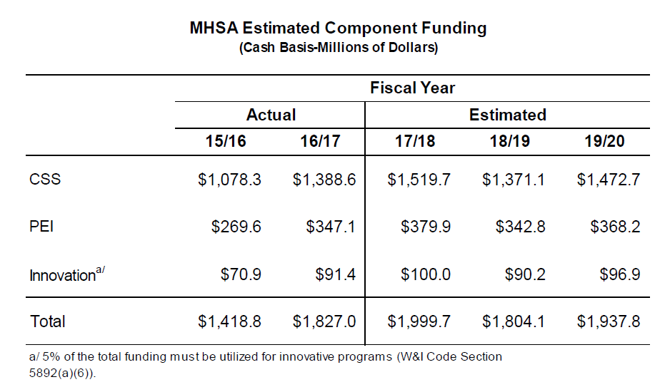
Fiscal Report
MHSA Fiscal Update
FY 2018/19 MHSA Revenue projected to decrease by about 10% due to
No Place Like Home $140M
Annual Adjustment for state $272.5M

Slide 19
Fiscal Report
MHSA Fiscal Update
FY 2018/19 Adopted Budget is $17.6M (MHSA $13.4M/Other Revenue $4.2M)
CSS: $13.2M
PEI: $2.7M
INN: $993K
WET: $157K
CFTN (Electronic Health Record Support): $537K
Prudent Reserve Balances:
CSS: $4,336,547
Amount proposed to transfer FY 17/18 approx. $1.2M
Amount proposed to transfer FY 18/19 approx. $1.3M
PEI: $67,608
Proposed SB 192 Prudent Reserve guidance

Slide 20
Fiscal Report
MHSA Fiscal Update
CSS Update:
Beginning in FY 18/19 projected possibility to add $600K per year in services
Full Service Partnership Majority of CSS Funding (51%)
Update to Revenue & Expense Report (RER) calculation is total FSP funding divided by total CSS funding
FY 18/19 budgeted at 42%
Includes 20% Work Plan 5 Wellness & Recovery and Work Plan 6 Enhanced Crisis redirected $715K
Add $2.3M growth to FSP programs (not sustainable) or redirect CSS funding to FSP programs $1.1M or a combination of both

Slide 21
Fiscal Report
MHSA Fiscal Update
PEI Update:
No projected additional funding available at this time
Innovation Update:
Round 3 projects to begin in FY 18/19
Round 4 projects to begin in FY 19/20:
Can add up to $500K per year for the project
Workforce, Education & Training Update:
FY 17/18 transfer CSS funds to WET
FY 18/19 AB114 funding

Slide 22
Fiscal Report
MHSA Fiscal Update
Reversion
AB 114 addressed funds deemed to be reverted as of July 1, 2017
DHCS letter for CSS, PEI, INN funds through FY 2014-15
Innovation reverted and reallocated = $429K
WET reverted and reallocated = $76K
Spending Plan approved by Behavioral Health Board June 20, 2018
Reallocated funds to be spent by June 30, 2020

Slide 23
Fiscal Report
MHSA Fiscal Update
Fiscal Reporting Tool
Mental Health Services Oversight & Accountability Commission (MHSOAC)
- Provides RER by County for past fiscal years
http://mhsoac.ca.gov/fiscal-reporting

Slide 24
New Business
Old Business
Triage Grant Update
Support for Community Action Team, update
LGBTQ Needs Assessment, update
FSP (incl. AOT FSP) contract changes
FSP for Child/Youth RFP – Update
County staffing

Slide 25
New Business
New Business
FSP 51% Decisions
Wish List Development
New proposal format
Infrastructure/staffing review

Slide 26
Next Meetings
Upcoming Meetings
MHSA Advisory (MAC)
Tuesday, August 28, 2018
4:00pm – 5:30pm
South County TBD

Slide 27
Thank You
Frank Warren
MHSA Coordinator
Prevention & Outreach Division Manager
SLO County Behavioral Health Dept.
fwarren@co.slo.ca.us
(805)788-2055

