Slide 1
County of San Luis Obispo
Behavioral Health Service Act (BHSA) formally the Mental Health Services Act (MHSA)
3-Year Integrated Plan (IP)
FY 2026-2029
Behavioral Health Board & Community
IP Training
Presenters:
Dr. Christina Rajlal
Morgan Torell
Landon King

Slide 2
Presentation Overview:
IP vs MHSA 3-Year Plan Differences.
What information does the IP contain?
IP Dissemination, Approval Timeline, Role of Community Program Planning Process (CPPP) & Behavioral Health Board.
BHSA Funding Expectations for next 3-years.
Notes:
Christina

Slide 3
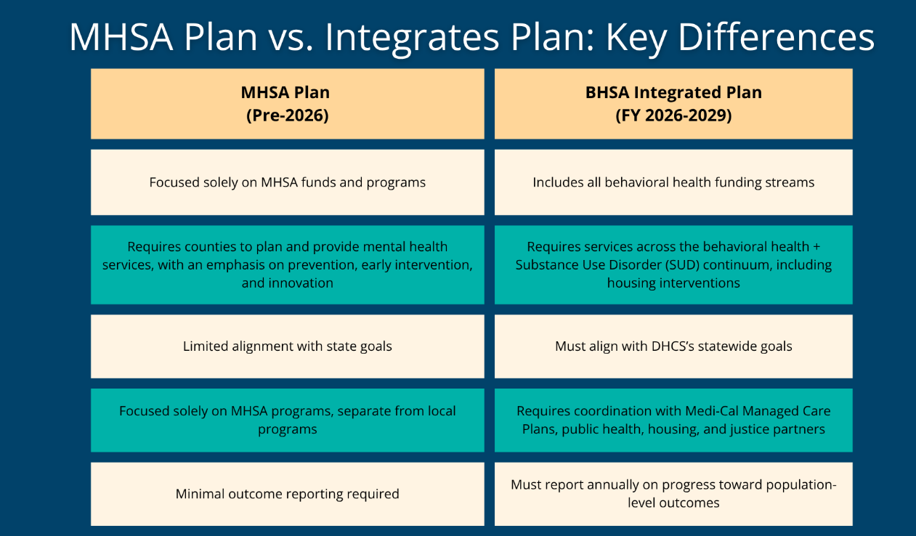

MHSA 3-Year Plan vs BHSA Integrated Plan: Key Differences
Notes:
Aligns with the evolving statewide goals of DHCS…

Slide 4
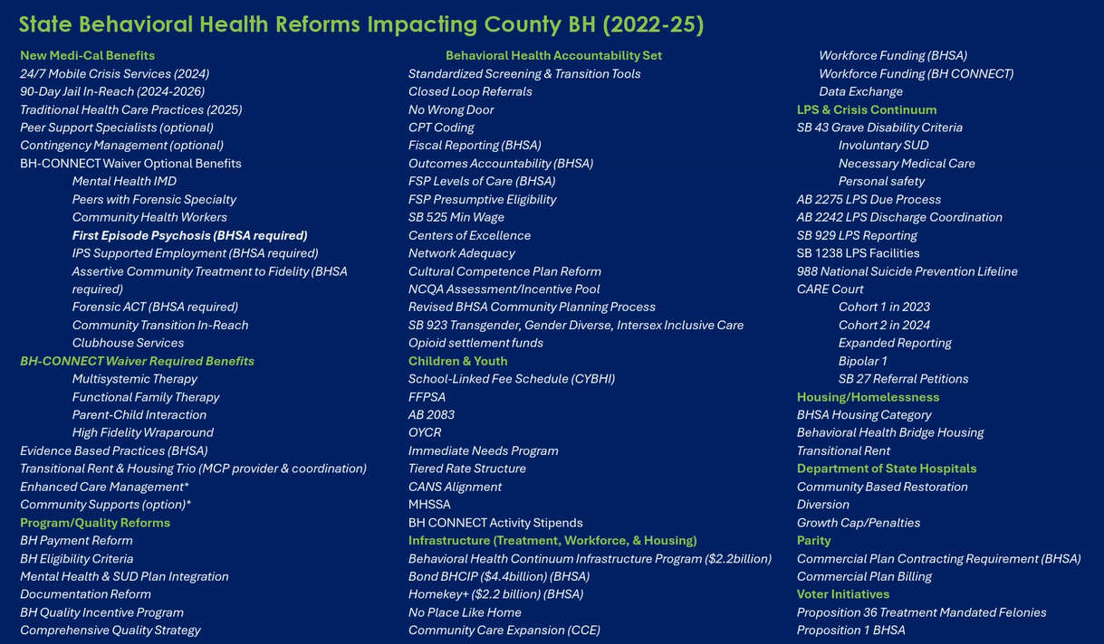

Notes:
Christina
86 initiatives

Slide 5
IP Sections
County Behavioral Health Systems Overview.
  Population Data.
  Service Delivery Landscape.
Statewide BH Goals.
  Population-Level Measures.
  Priorities.
Community Planning Process.
Comment Period & Public Hearing (Updated After Public Hearing).
County BH Services Care Continuum.
County Provider Monitoring & Oversight.
  Medi-Cal Quality Improvement Plan.
  BHSA Provider Locations.
BHSA Funded Programs.
Workforce Strategy.
3-year Budget Summary.
Approvals & Compliance

Slide 6
IP CPP & Approval Timeline
Behavioral Health Board IP Prep & Education
TODAY
Board of Supervisors BH Transformation Presentation
12/16
Start 30-Day Public Review Mid-Dec
CPP Advisor Email/Press Release/Social Media Blast/Print Media
Public Hearing at BHB 1/21
Board of Supervisors & CAO Approval
February 2026
End 30-Day Public Review Mid-January
Submit Final Draft to DHCS in March

Slide 7
BHSA 3-Year Funding Plan
Majority of current programs, services, and costs will move into Year 1 of IP.
  Possible reductions in vacant County positions.
  Transition of school services to CYBHI.
Funding Components:
  Projected annual state allocations (BHSA revenue).
  Medi-Cal revenue & enhancements.
  MHSA rollover dollars created by proactive realignment of BHSA eligible services.
Fiscal Expectations & Uncertainties:
  Expect Year-to-Year Adjustments to 3-year Plan.
    State BHT initiatives continue to evolve.
    Impact of Federal Policies.
    Unexpected Future Costs.
      Evidence-Based Practice (EBP) implementation.
      Cost of living variance.
      State allocation fluctuations year-to-year.

Slide 8
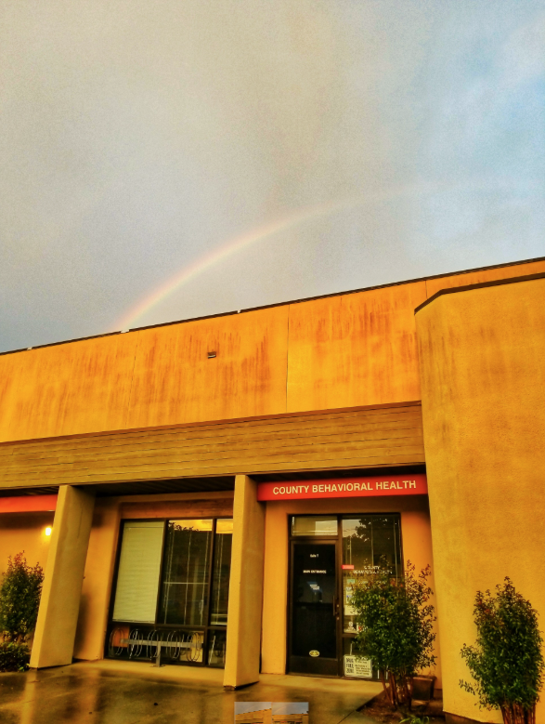
We Welcome Your Questions!
Thank you!
Dr. Christina Rajlal
Division Manager Prevention & Outreach Services
crajlal@co.slo.ca.us
Morgan Torell
Business Systems Analyst
mtorell@co.slo.ca.us
Landon King
BHSA Policy & Administrative Manager
lking@co.slo.ca.us

