Slide 1
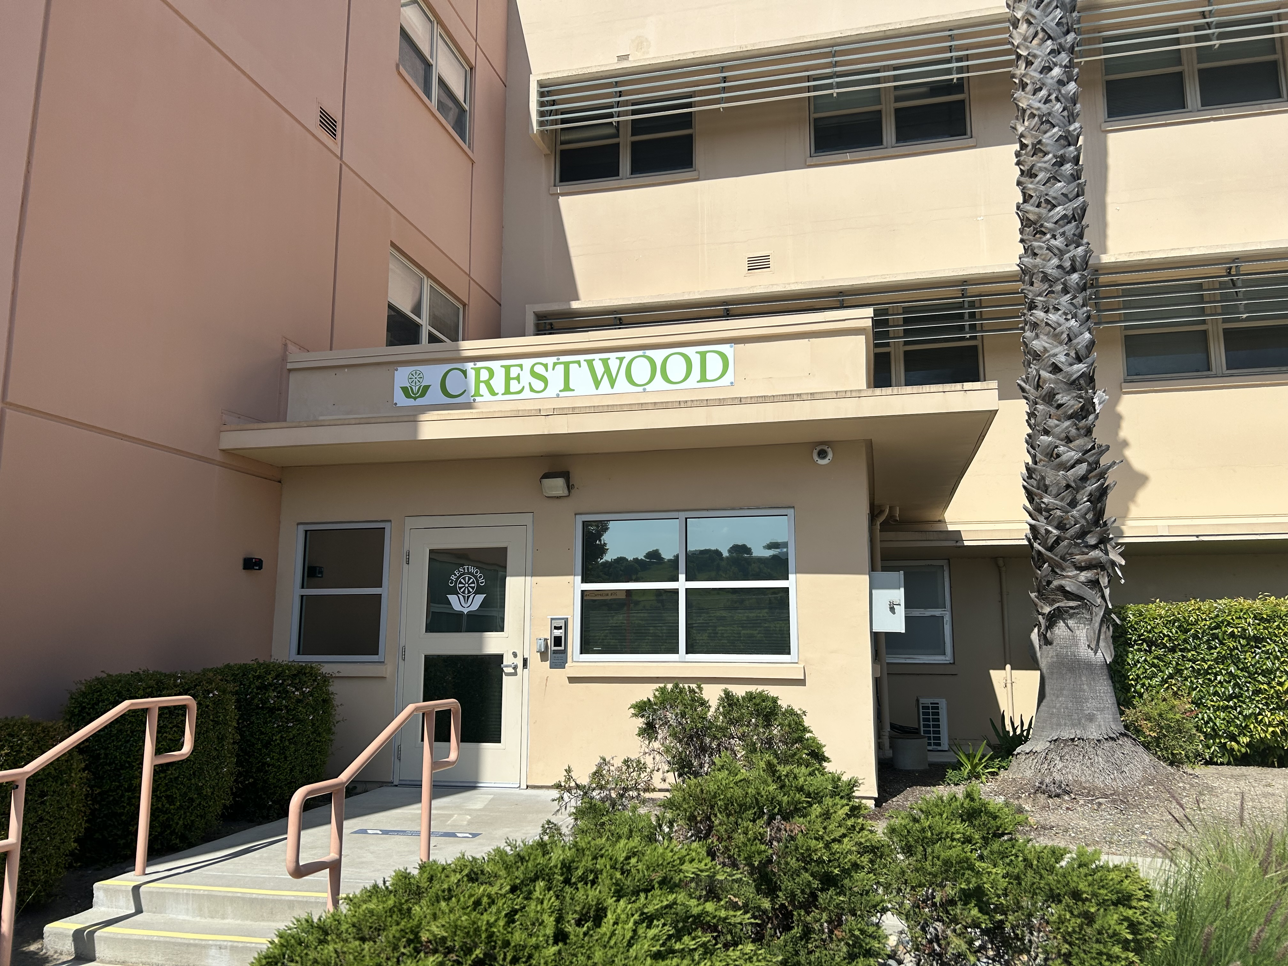
Crestwood Behavioral Health
16 bed in-patient facility

Slide 2

History
2
Headquartered in Sacramento, California
Founded in 1968 by James M. Dobbins, Sr. as Crestwood Hospitals Inc., a convalescent care provider.
  Family experience prompted him to create Crestwood

Slide 3

Mission Statement
3
    Our mission at Crestwood Behavioral Health Inc. is to create a partnership with clients, employees, families, business associates and the community in caring for individuals of all ages affected by mental health. Together, we invest our energy to enhance the quality of life, social integration, community support and empowerment of mental health clients.

Slide 4
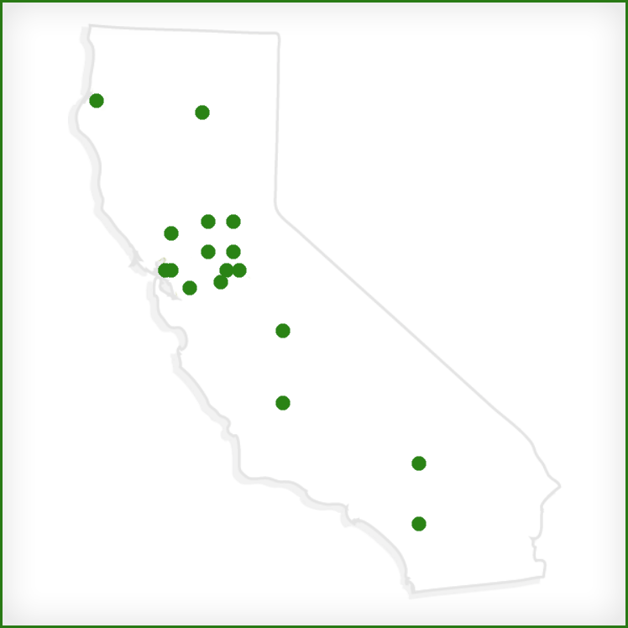
Locations in California
2178 Johnson Ave, SLO

Slide 5










Programs
Mental Health Rehabilitation Centers (MHRC); 12
Psychiatric Health Facilities (PHF); 7
Adult Residential Programs; 7
Crisis Stabilization Services (CSS); 3
Crisis Residential Treatment Program; 2
Residential Care for Elderly; 1
Skilled Nursing Facility (Neuro-Behavioral); 2
Skilled Nursing Facilities (SNF);4
Mobile Crisis Services; 1

Slide 6

Pillars
Family
Enthusiasm
Compassion
Flexibility
Commitment
Character

Slide 7

Clinical Roles
Recovery Coach
Recreation team
Service Coordinator
LPT, LVN, RN
Licensed Clinician (LCSW)
Clinical Director (LMFT)
Program Director
Director of Nursing (RN)
Psychiatrist/Medical Director

Slide 8

Day to Day Operations
No mechanical restraints
Daily Programing with staff and guest participation
  Wellness recovery action plan, Dialectical Behavioral Therapy skills, Compassionate Care, Trauma Informed Approaches
Interdisciplinary Team Meetings
Environment is resiliency focused
Not One Minute More Initiative
Guests are primarily admitted on a 5150 hold (DTS, DTO, GD)
  Conservatorship
  5250/5270/5270 Intensive
Average census: 14
Average length of stay is 8 days
Welcome room and Quiet room

Slide 9
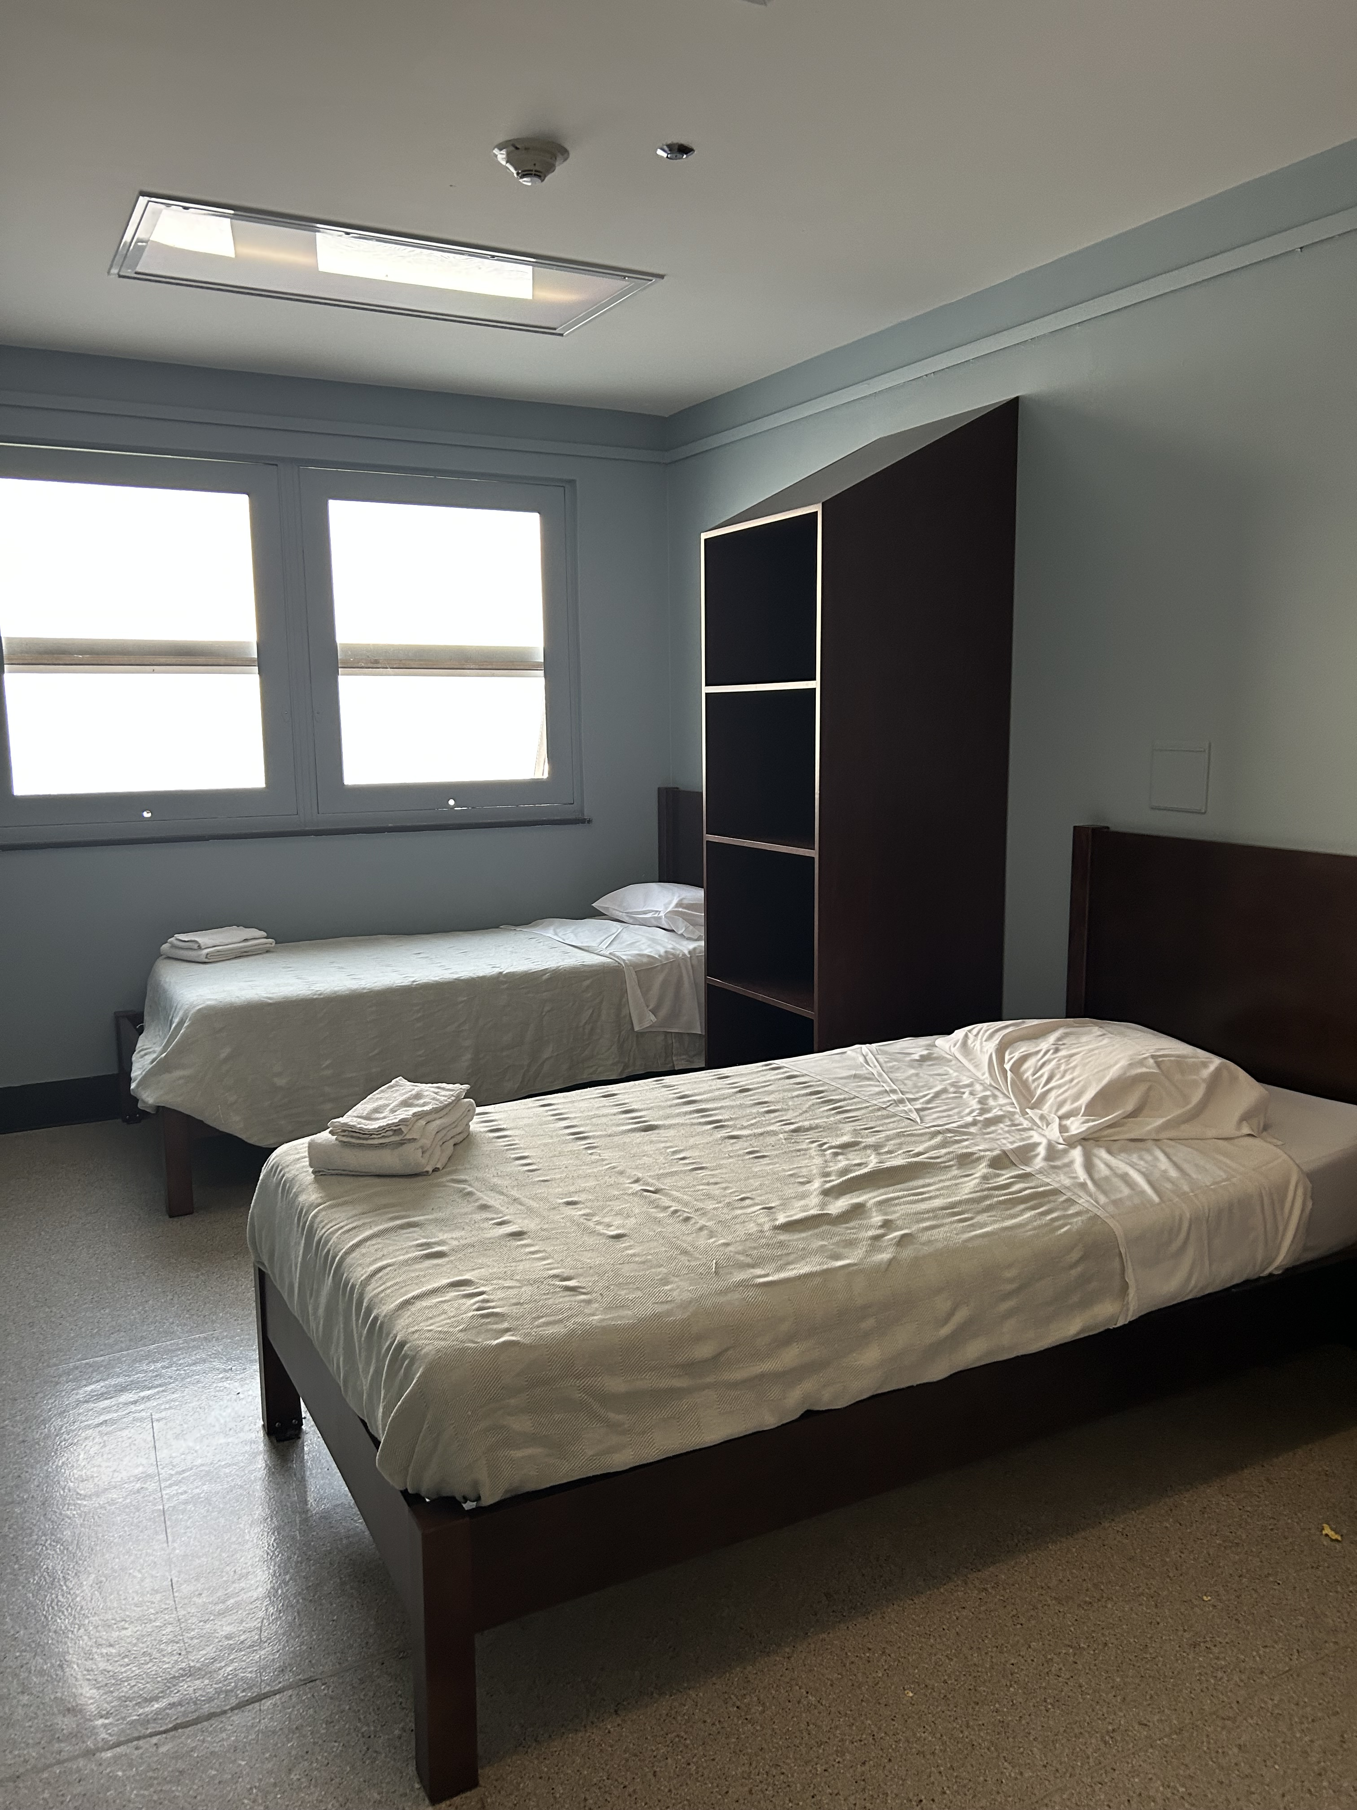
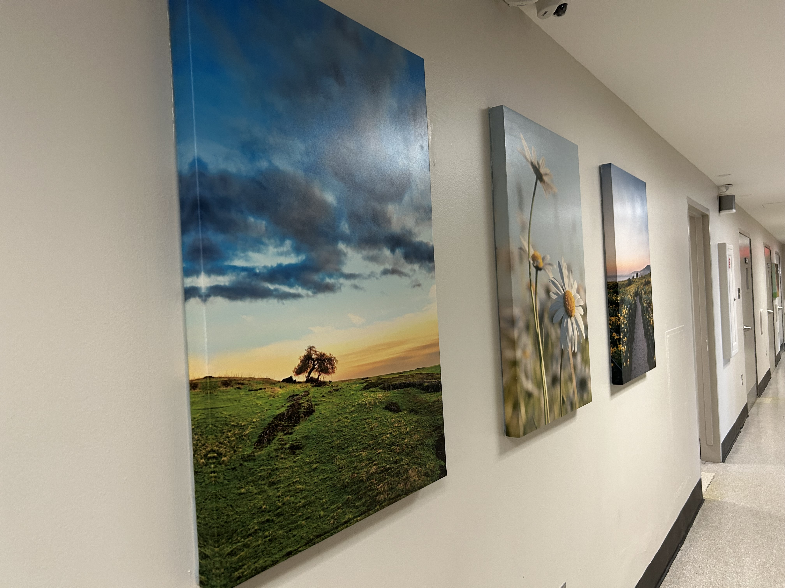
Crestwood Facility

Slide 10
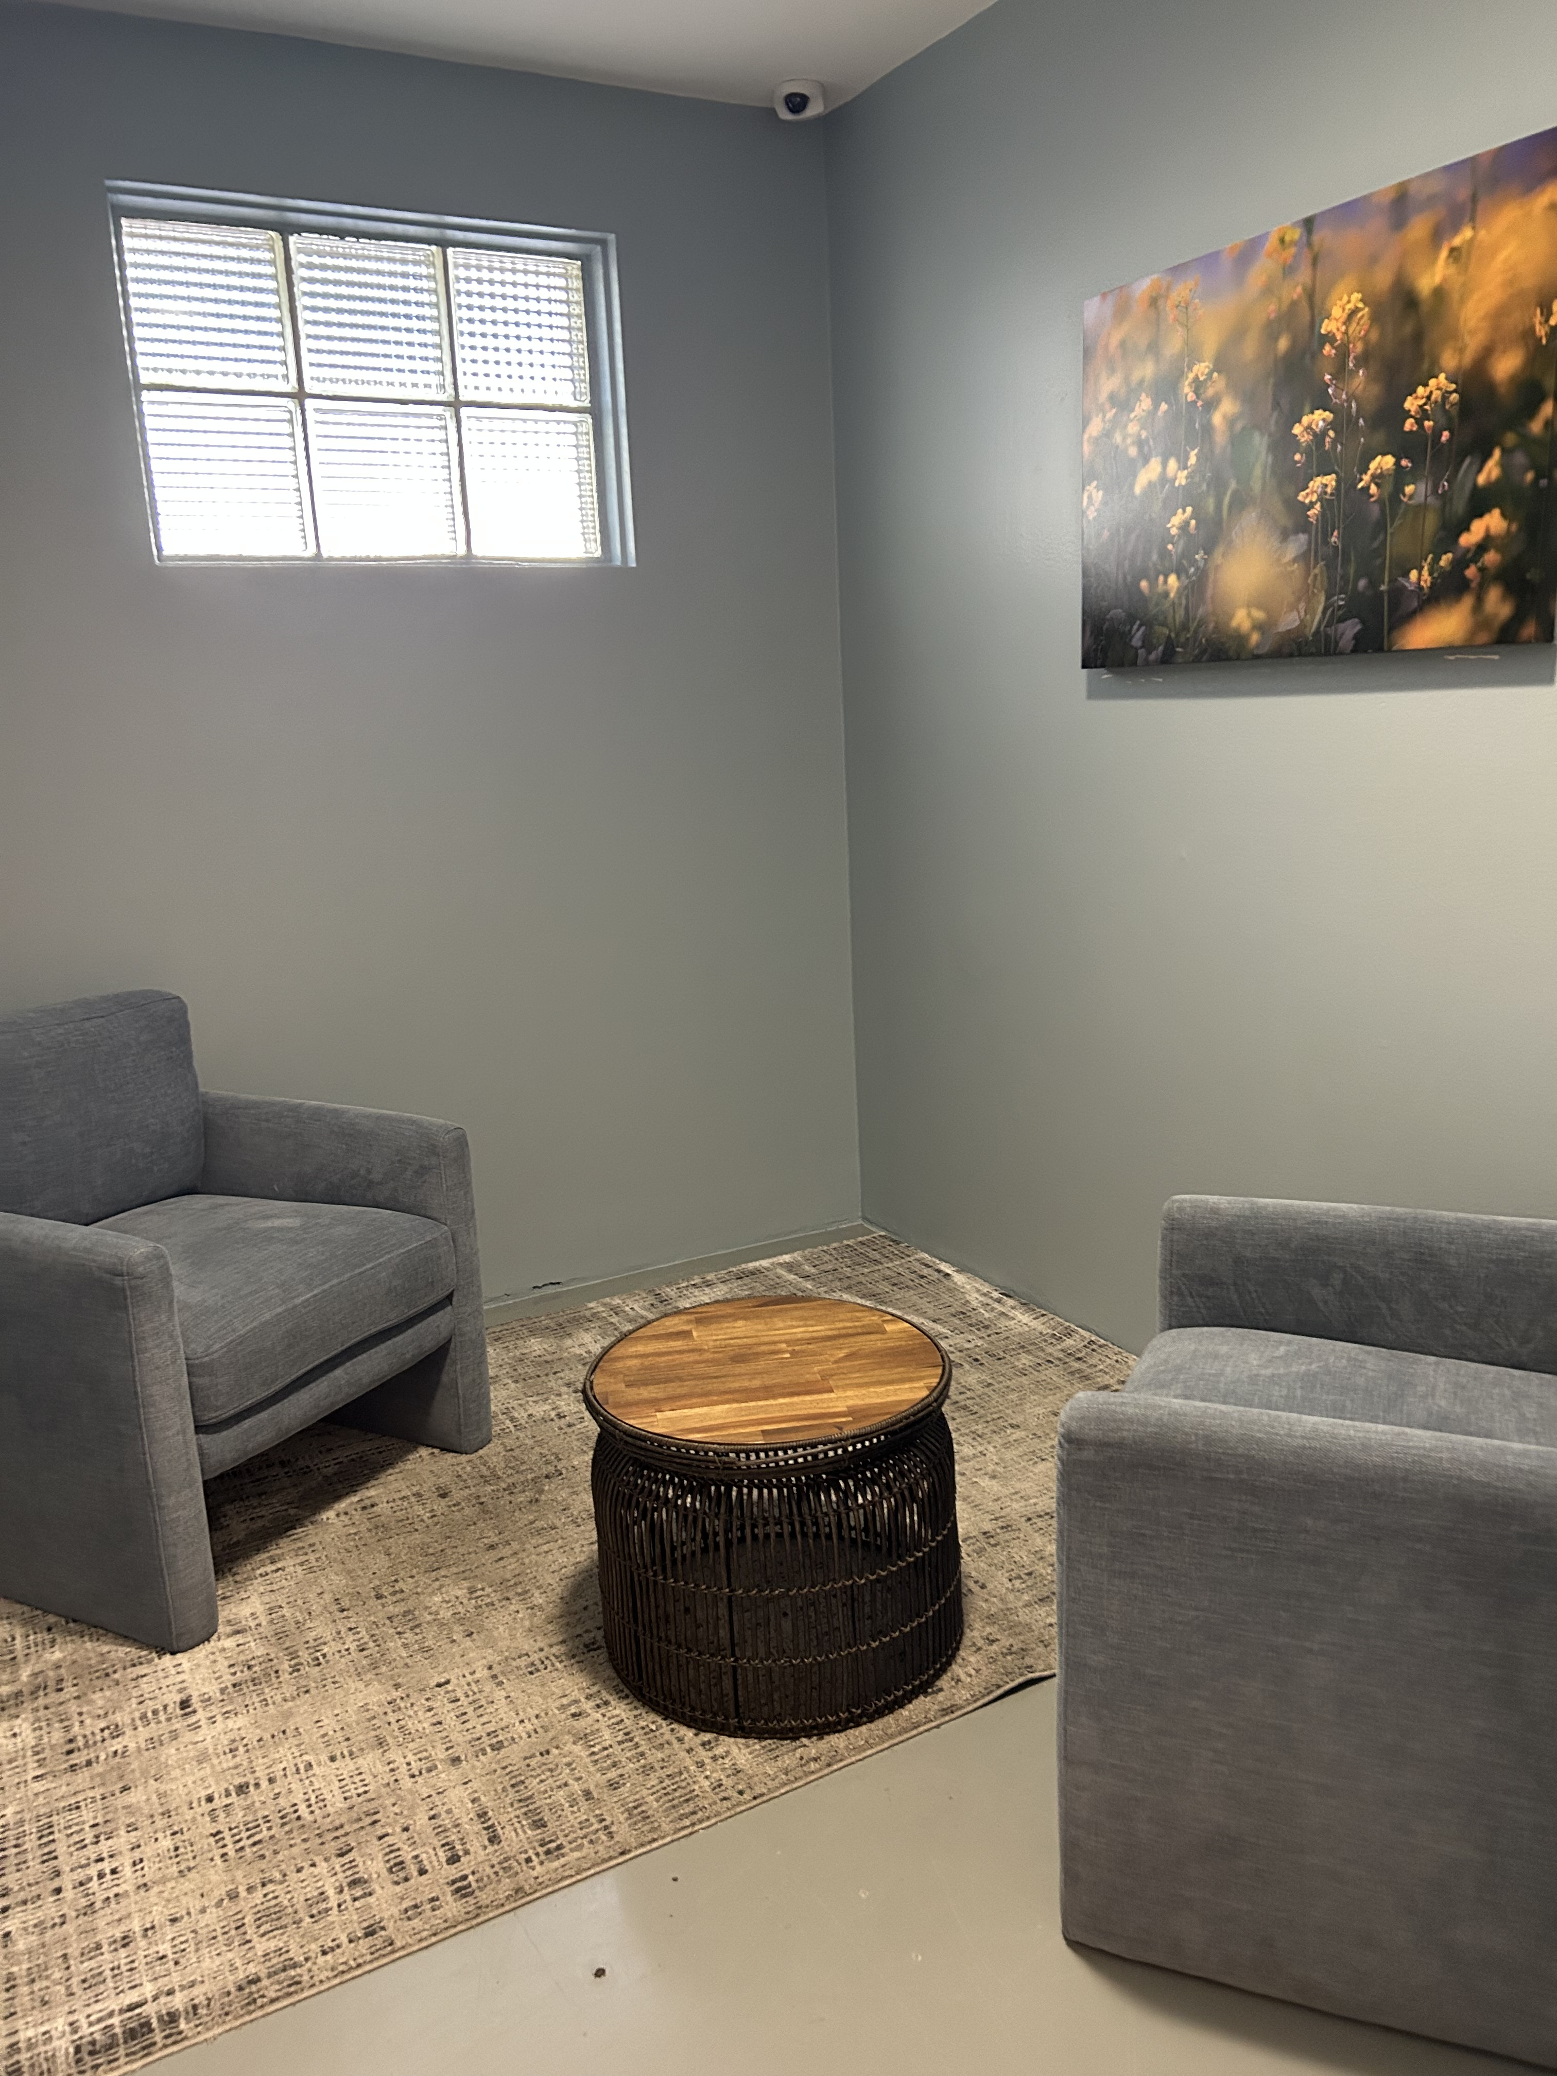
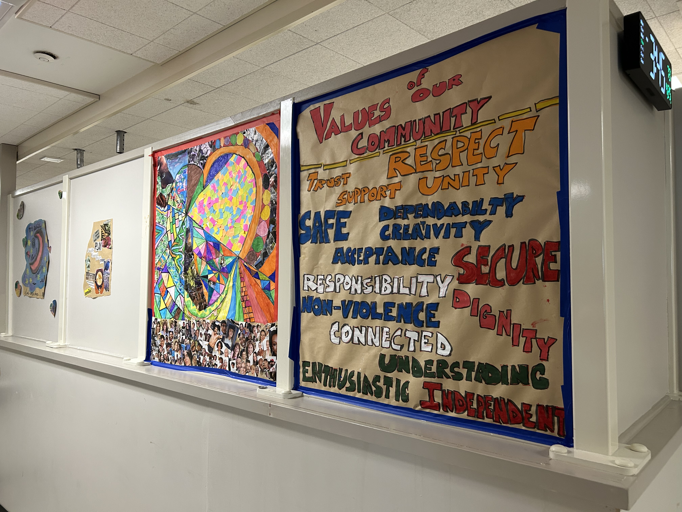
Crestwood Facility

Slide 11

Collaboration
County Mental Health
  Outpatient Clinics/ Drug and Alcohol/CAT
  Assisted Outpatient Team (AOT)
  Public Guardian
SLO County jail/Well path
Prado/Echo Shelters/5 Cities Coalition
Transitions Mental Health (THMA)
  Homeless Outreach Team (HOT)
Family Care Network, Inc (FCNI)
Justice Services
Public Guardian
Emergency Departments
Sierra Wellness (CSU and dispatch)
Sobering Center/Residential facilities

Slide 12
Admit Location
 | 2023Q3 | 2023Q4 | 2024Q1 | 2024Q2 | Grand Total
Dignity Health - French Hospital Medical Center | 34 | 34 | 50 | 58 | 176
Twin Cities Community Hospital | 32 | 38 | 22 | 40 | 132
(blank) | 72 | 15 | 10 | 5 | 102
Arroyo Grande Community Hospital | 19 | 22 | 26 | 31 | 98
Sierra Vista Regional Medical Center | 11 | 19 | 24 | 30 | 84
San Luis Obispo County Jail |  | 6 | 3 | 1 | 10
Marian Regional Medical Center |  | 2 | 5 | 2 | 9
San Luis Obispo PHF (1171) | 3 |  |  |  | 3
Lompoc MHRC (1170) |  |  | 1 |  | 1
Grand Total | 171 | 136 | 141 | 167 | 615

Slide 13
Discharge Location
 | 2023Q3 | 2023Q4 | 2024Q1 | 2024Q2 | Grand Total
Private home/apt. with no home health services | 46 | 46 | 46 | 66 | 204
Shelter | 39 | 22 | 38 | 40 | 139
Home | 44 | 33 | 23 | 31 | 131
Self | 23 | 9 | 14 | 10 | 56
Jail/Corrections | 3 | 6 | 11 | 5 | 25
Board and care/Group home | 4 | 5 | 2 | 2 | 13
Acute Care Hospital | 1 | 3 | 2 | 6 | 12
Transitional Housing | 3 | 3 | 1 | 2 | 9
Crestwood | 1 | 5 |  |  | 6
Hotel | 2 | 1 | 1 | 2 | 6
Grand Total | 166 | 133 | 138 | 164 | 601

Slide 14
Length of Stay
LengthOfStay
 | Average of LengthOfStay
2023Q4 | 10.0
2024Q1 | 9.1
2024Q2 | 6.5
2024Q3 | 6.3
Grand Total | 8.3

Slide 15
Average of Age
Row Labels | Average of Age
2023Q3 | 39
2023Q4 | 40
2024Q1 | 39
2024Q2 | 40
Grand Total | 40

Slide 16
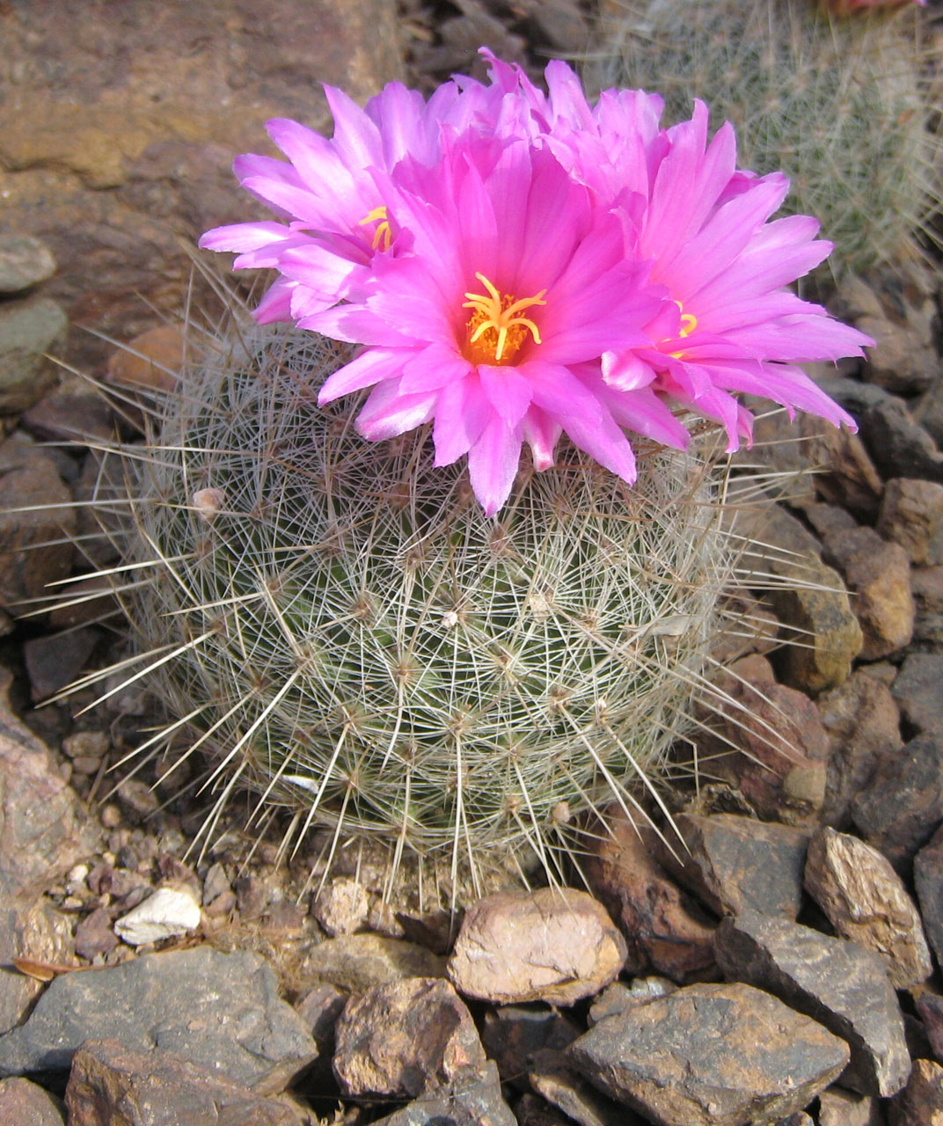
Thank You
Danielle Martinez, LMFT
Clinical Director/Administrator
805-891-7387
danielle.martinez@cbhi.net
crestwoodbehavioralhealth.com

