Slide 1
San Luis Obispo
Sobering Center
2180 JOHNSON AVE SAN LUIS OBISPO, CA 93401

Slide 2
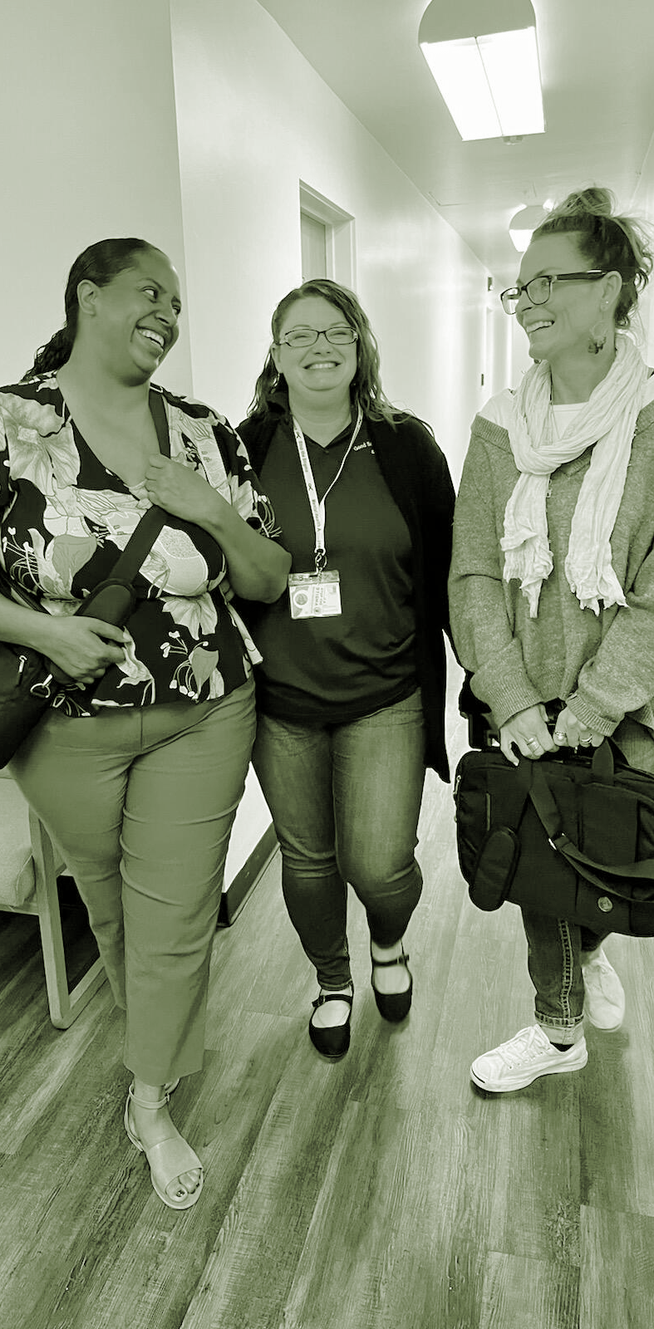
About Good Samaritan
Our Mission
Provide emergency, transitional, and support services to the homeless and those in recovery throughout the greater Santa Maria valley and Central Coast.
Our Services
Shelter & Housing Sobering & Stabilization
Clean & Sober Living Jail & Correctional Services
Mental Health Services Parent & Children Services
Veteran Services Women’s Treatment
Residential Treatment Outpatient Treatment

Slide 3
SLO Sobering Center (managed by GSS)
Provides short-term sobering and transition services (e.g., from jail and/or those who have been assigned a bed in a residential program within the next few days).
The Center strives to divert individuals from jail and potential legal repercussions of minor offenses and will be used to connect them to mental health and substance use treatment services, case management, housing, and other services available in the area.
12 beds
Designed to last 24 hours
Individuals can remain for up to 72 hours on a case-by-case basis
Accepts CENCAL

Slide 4
Services Provided
A medical screening is provided upon arrival to assess individual needs.
Individuals are assigned a locker to secure personal items and are offered hygiene kits as needed.
Staff check vitals, and provide hydration, various meal choices, and snacks throughout the day.
Med staff can provide medical clearance and drug testing as needed for treatment program admission.
Staff provide referrals and linkages to services:
mental health & substance use treatment
housing support
legal services
social services
case management
transportation
food assistance
basic necessities

Slide 5
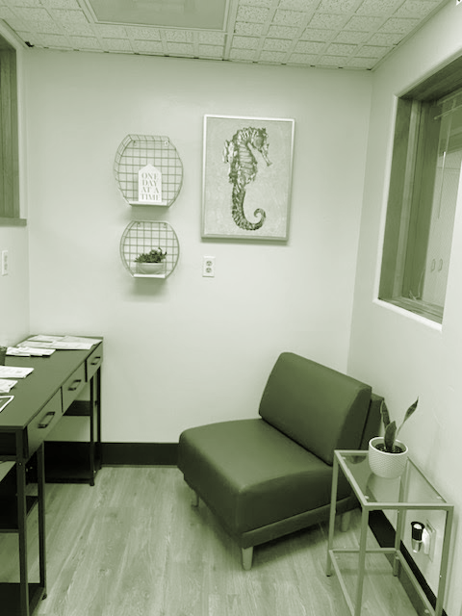
Exclusion Criteria
Under the age of 18
Unable or unwilling to cooperate with the screening exam
Combative or agitated Primary concern of serious mental illness
Incontinent
Unable to walk without assistance or has other medical needs that cannot be managed in a non-acute setting
Registered sex offender

Slide 6
126 Admissions
3 Days
between 6/15/24-10/14/24
Average daily census and length of stay

Slide 7
Brought in by:
Discharge to:
Substance use:
SLO County Programs
THMA …………………………………………..……. 5
CSU ……………………………………………..…….. 10
Sierra Mobile Crisis team …………….……… 4
MET Crisis team …………………………….…… 1
Crisis team …………………………………….…… 10
Slo Public Health Dept ……………………….. 2
Prado/Echo Shelter ………………………….… 5
SLO Drug/Alcohol Services ………………… 17
Sober Living Sun St …………………………..… 1
Sober Living Gryphon ……………………….… 2
Probation …………………………………………… 13
Police Dept ………………………………………… 2
Fire Dept ………………………………….………… 2
Dignity ER/OPU ……………………..……….…. 11
Self ……………………………………………..….…… 23
Family ……………………………………………..….. 2
Good Samaritan ………………………………..… 3
Bwell SB County …………………………………. 2
Family Reunification …………………………… 17
Shelter …………………………………..…………… 16
Street/ Hotel ………………..……………………. 50
Hospital ……………………………………...……… 5
Home ……………………………………………….… 13
Treatment …………………………………………… 2
Sober livings ……………………………….………. 11
Court ………………………………………….…….… 1
Probation ………………………………….……..…. 1
CSU ………………………………………….…….….. 1
Good Sam Services ………………….…………. 5
Meth ……………..………………………….… 38
Alcohol ………..……………………………... 68
Opiates ……………………………..………… 22
Cannabis ……………..………….………….. 10
Benzodiazepines …………………………. 3
Cocaine ……………………………………….. 1

Slide 8
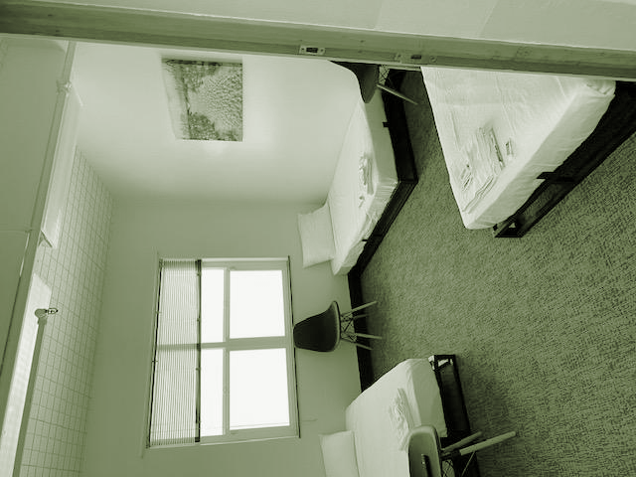
Contact Information
Call (820) 280-0415 to ensure a bed is available.
Once confirmed that a bed is available, individuals will arrive, receive medical screening, and be admitted.
SLO Sobering Center is located at:
2180 Johnson Ave. San Luis Obispo, CA 93401

Slide 9

QUOTE
Sometimes we plant trees that give shade to plants we never get to see.

Slide 10
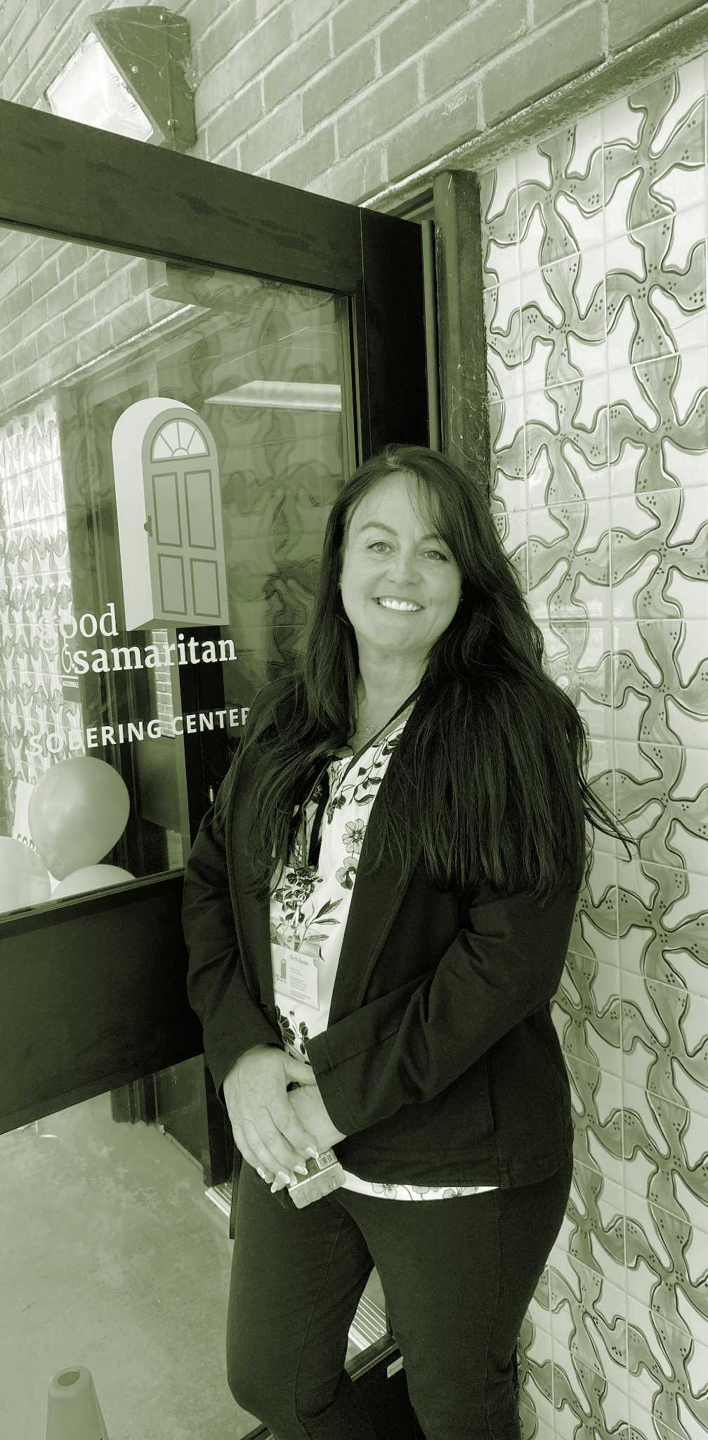
Program Manager
Terri Houser
(820) 280-0415
Office: slosc@goodsamaritanshelter.org
Email: thouser@goodsamaritanshelter.org

