Slide 1
Sierra Mental Wellness Group
Providing Crisis Services to San Luis Obispo County

Slide 2
Sierra Mental Wellness Group

Slide 3
Sierra Mental Wellness Group
Non-Profit Company based out of Roseville, California
Provides crisis services for 5 counties and 1 divided city throughout the state of California
Central Coast regional services include San Luis Obispo County and Monterey County
Contractor with San Luis Obispo County
2015 – Began providing behavioral health crisis services to San Luis Obispo County

Slide 4
Our Mission
To provide emergency behavioral health crisis stabilization services to the community
To improve access to services through linkage and/or referral to community agencies
To ensure timely follow-up and referral services
To collaborate with and support local community-based organizations

Slide 5
Mobile Crisis Services

Slide 6
Leadership Team
Leah DeRose LMFT
Mobile Crisis Supervisor
Boone Tucker
Assistant Supervisor
Josh Simpson
Regional Manager of Program Operations

Slide 7
Mobile Crisis Services
Available 24/7/365 (including holidays)
Provides stabilizing supportive services, behavioral health assessments, and 5150 evaluations to persons in crisis within San Luis Obispo County
Mobile Crisis Team (MCT): Responds in 2-person teams to all community-based locations
Mental Health Evaluation Team (MHET): Responds to all 4 local hospitals and other facility settings

Slide 8
How We Serve San Luis Obispo County
Respond 24/7 to behavioral health crisis calls throughout San Luis Obispo County
Support persons experiencing a behavioral health crisis through stabilization, de-escalation, and safety planning
Assess any adult or child who has a behavioral health emergency, is at risk of severe harm to self or others, or who may require psychiatric hospitalization

Slide 9
How We Serve San Luis Obispo County
Collaborate with community partners and agencies to determine the most appropriate level of care for persons experiencing a behavioral health crisis
Assist hospitals, law enforcement, fire and social services in responding to behavioral health emergencies

Slide 10
Mobile Crisis Responds to all San Luis Obispo County Cities and Unincorporated Areas
Private Residences
Local Hospitals
Law Enforcement Co-Response
Local Schools
Cal Poly University & Cuesta College
SLO County Behavioral Health Clinics
Mental Health Clinics
Private Counseling Offices
Health Care Clinics
Medical Offices
Private Doctor’s Offices
Residential Treatment Programs
Psychiatric Health Facility
Juvenile Hall
Other Community Locations

Slide 11
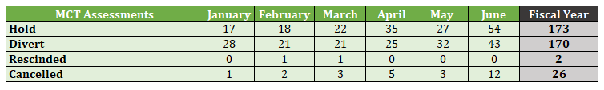


Mobile Crisis Data

Slide 12
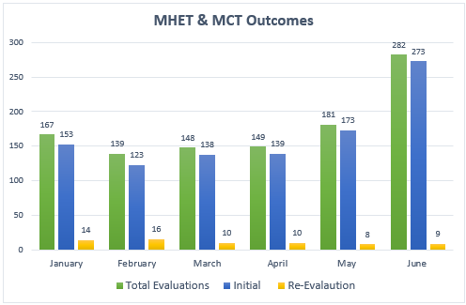
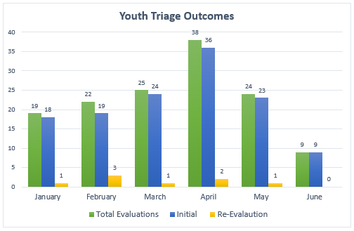
Mobile Crisis data
Total Evaluations: 1203

Slide 13
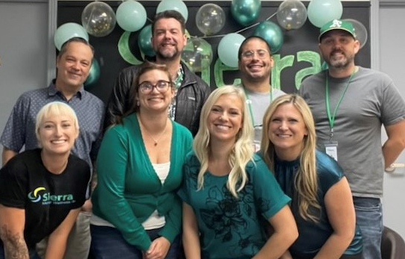
How to Contact Mobile Crisis Services
Community Members: 1-800-783-0607
Partner Agencies: Crisis Dispatch Center

Slide 14
Crisis Dispatch Center

Slide 15
Leadership Team
Bretney Padilla, LPT
Crisis Dispatch Center Supervisor
Josh Simpson
Regional Manager of Program Operations

Slide 16
Crisis Dispatch Center
Who We Are (and Aren’t)
24/7 Internal Facing Call Center
The Crisis Dispatch Center is an internal professional service to support the crisis continuum system
It is not a crisis prevention service or replacement of 9-8-8 or the Central Coast Hotline
Dispatch staff are administrative support and have limited training in crisis prevention and de-escalation

Slide 17
Crisis Dispatch Center
What We Do
Provide administrative support to crisis services
Triage and collect pertinent details for crisis requests
Secure placement at acute psychiatric facilities for persons on a 5150 hold
Arrange transportation for transfers between facilities
Schedule Post-Hospitalization appointments

Slide 18
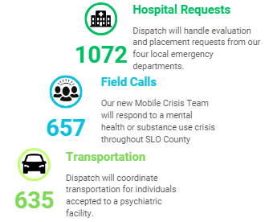
Crisis Dispatch Center
Data March 1st- August 31st

Slide 19
Mobile Crisis Service Requests
How to Request Mobile Crisis Services
Community Members
Call the Central Coast Hotline at 1-800-783-0607 and request the Mobile Crisis Team
Partner Agencies
Call the Crisis Dispatch Center to request mobile crisis services and provide details of the crisis situation

Slide 20
Josh Simpson
Regional Manager of Program Operations
Boone Tucker
Mobile Crisis Service Assistant Supervisor
Leah DeRose
Mobile Crisis Services Supervisor
Bretney Padilla, LPT
BH Crisis Dispatch Center Supervisor
805-439-4890
staff@sierramentalwellness.org

