Slide 2
Behavioral Health - Budget
Historical Trend
Current
Future - What are we working towards, what is coming our way?

Slide 3
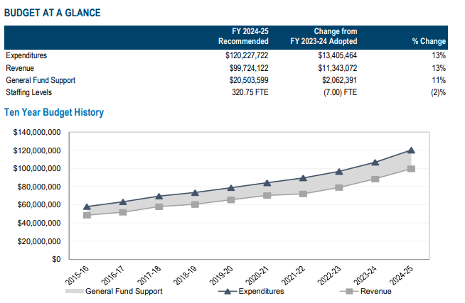
Behavioral Health – Budget at a Glance

Slide 4
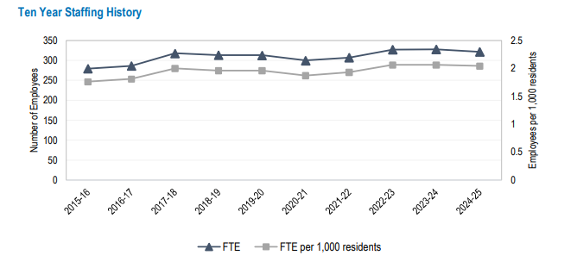
Behavioral Health – 10 Yr Staffing History

Slide 5
FY 2023-24 Year End

Slide 6
Behavioral Health FY 2024-25 Budget

Slide 9
Maximizing Medi-Cal
    Increasing Productivity for Billable Services
    Billing all eligible services
    Adapting to Cal Aim Payment Reform
    Building Reporting for evaluating program revenues

Slide 10
Realignment – Approx $24M - $27M
1991
  Approx. $8M
  Sales Tax and VLF
2011
  Approx. $14M-$16M
  Majority Sales Tax
AB109
  Approx. $2M-$3M

Slide 11
Behavioral Health – Future & Challenges
  Reduce Expenditures
  Evaluate budget on a program level
    Mandated vs Non-Mandated or Discretionary Services
  County budget constraints
    General Fund Dollars
  Economy
      Increase in costs of services and supplies
      Increase in labor – SB 525 minimum wage increase

Slide 12
Behavioral Health – Future & Challenges
  Increase Revenues
    Maximizing Medi-Cal
      Increasing Productivity for Billable Services
      Billing all eligible services
    Continue to Seek grant funding
      Bridge Housing
    State initiatives: Adapting to CalAIM Payment Reform, Prop 1

