Slide 1




MENTAL HEALTH SERVICES ACT ANNUAL UPDATE
Reporting & Data from Fiscal Year 2024-2025
Draft Posted for 30-Day Review
September 16th – October 16th, 2025
Public Hearing: TODAY, October 15th, 2025.

Slide 2
MHSA Annual Update
Fiscal Year 2025-2026: Draft 30-Day Public Review
Draft Posting Timeline (BH Web Page) 9/16 – 10/16
Link sent to all MHSA Community Advisors, Behavioral Health Board, Community Partners, Behavioral Health Staff
Public posting in SLO Tribune weekly
Press release and social media released
Public Hearing held at BHB 10/15
Substantive comments addressed in final draft submitted to BOS (early 2026)
Comments collected via online tool
Final draft approved and submitted to MHSOAC in March 2026.

Slide 3
Online Survey Public Comments Received
Sadly…none ☹.

Slide 4
BHB Comments: Future Priorities
Ensure sustainable partnerships with mental health CBO’s such as TMHA, NAMI, FCN, and other community partners.
Reporting outcomes of enhancements to Medi-Cal billing.
Continuing to ensure that some services, such as Hotline and educational programs, will continue to be freely accessible (non-billed).
Continued measurements of Quality-of-Life indicators.

Slide 5
BHB Comments: Concerns
The discontinuation of PEI and WET programs due to BHSA reform.
Contribute to inequities with Spanish-speaking population.
Impact on youth and TAY services.
Reductions in resources for Suicide Prevention.
Impact on Peer Services.

Slide 6
Concerns Continued…
General concern of how reduced funding from County, State, and Federal government will reduce services for individuals outside of priority populations such as Unhoused and SUD.

Slide 7
Public Hearing: Written or Spoken Comments from Attending Board and Community

Slide 8
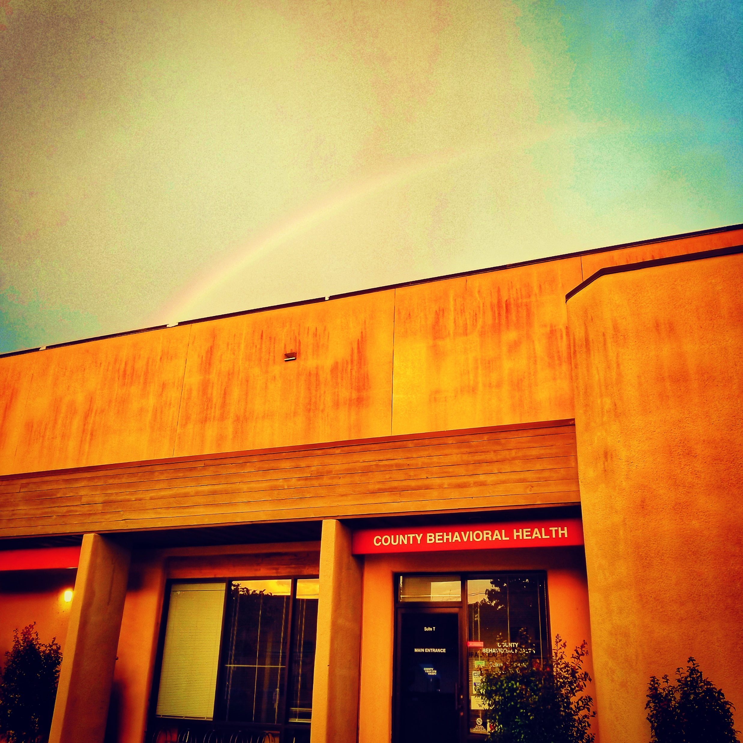
The MHSA Annual Update is available at
www.slobehavioralhealth.org
Thank you!
Dr. Christina Rajlal, PHD, MBA
Division Manager for Prevention & Outreach Services
crajlal@co.slo.ca.us
805-781-4276

