Slide 1

Coastal Valley Academy
Mobile Probation Services Center (MPSC)

Slide 2
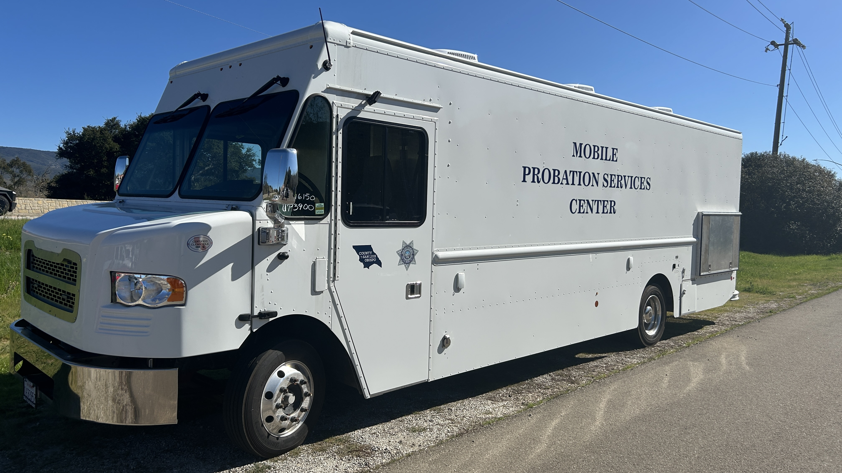
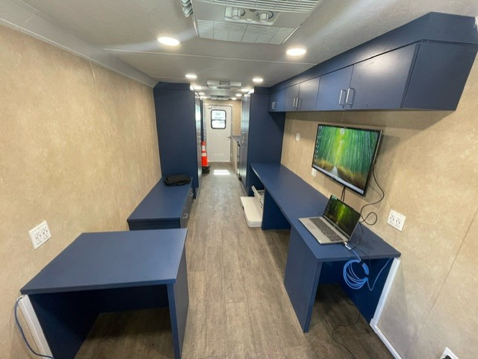
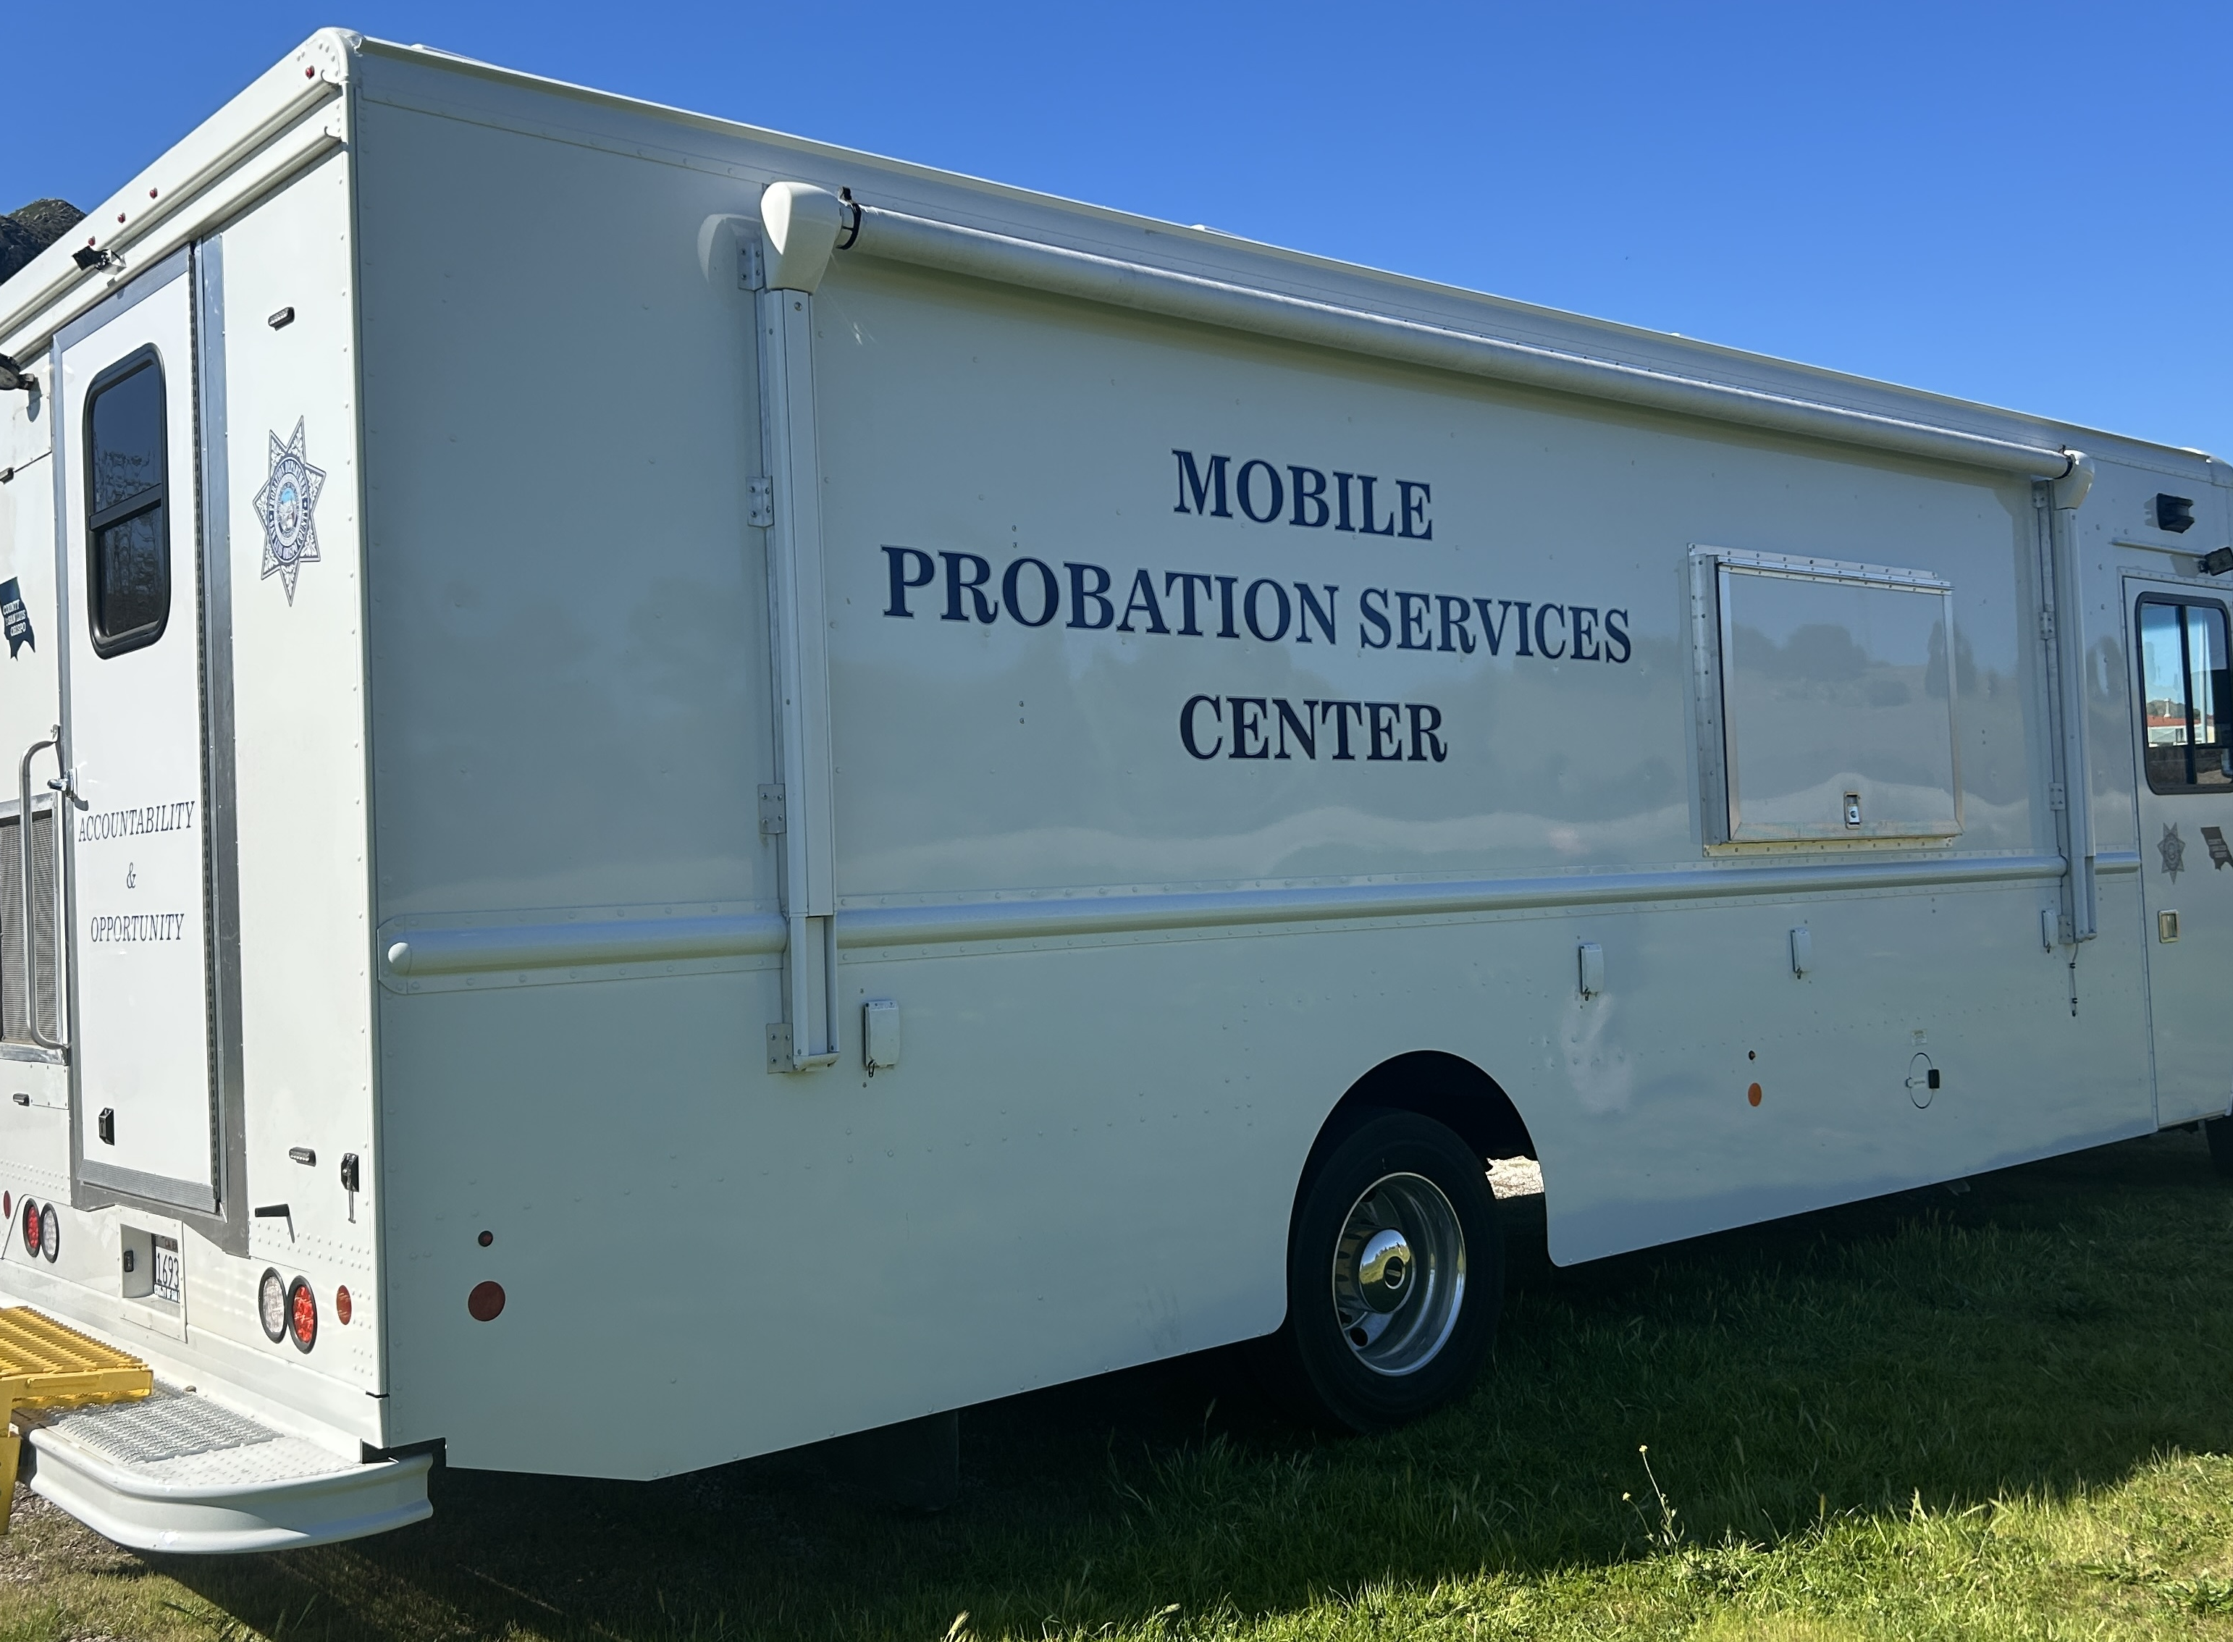
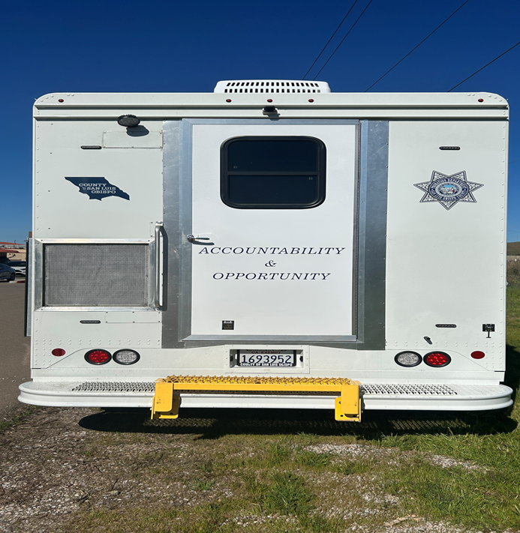
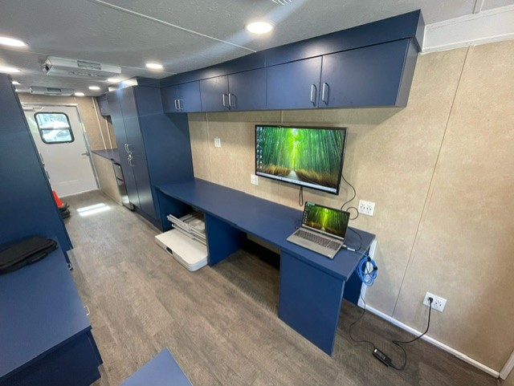
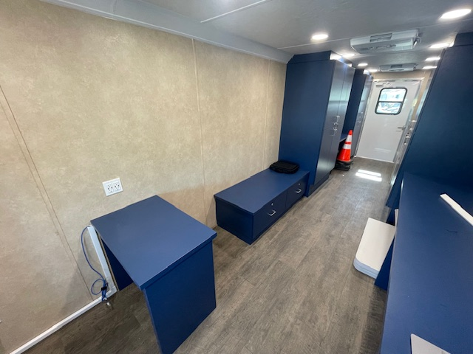
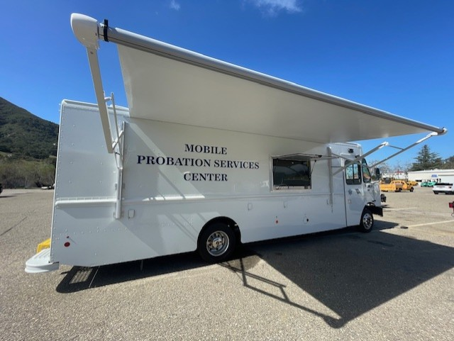
Mobile Probation Services Center (MPSC)

Slide 3
MPSC Details
24 Foot vehicle
Retrofitted w/ storage for necessities for Unhoused individuals
Sleeping bags, hygiene kits, apparel, etc.
Completely wired for secure county staff and visitor Wi-Fi
Two workstations – for DPO and Service Provider/CBO
Interior and exterior smart televisions
Self-powered via generator

Slide 4
Goals of the MPSC
Connect individuals to housing programs to get them off the streets.
Connect individuals to other supportive services to improve their enrollments into substance abuse treatment, mental health treatment and other court ordered programs.
Improve probation compliance and public safety by removing barriers to housing, transportation and social services support.
Unhoused Probation Officer working collaboratively with Providers

Slide 5
Other Program Goals
Long Term Injectable Medications – Mental Health and Substance Use
Video Conferencing – TV’s Camera Equipped
Mobile Court
Virtual check-ins with providers and probation
Expanded support for basic needs
Expanded schedule & locations

Slide 6
Targeted Outcomes
Increase screening for medical insurance eligibility
Reduce barriers to housing programs
Increase Probation compliance & strengthen public safety
Improve reporting/monitoring
Reduce warrants
Increased enrollment & participation in services
Substance use, mental health, and life skills

Slide 7
Who We Serve
All justice involved individuals on:
Formal Probation
PRCS/Mandatory Supervision (AB 109)
MH Diversion / HS 11395 / Pre-Trial (PAMP)
Not a justice involved individual?
We will serve as a connector to services/resources

Slide 8
Current Partner Organizations
5 Cities Homeless Coalition
Cabins for Change/Barca (4th Street)/Warming Center
Community Action Partnership SLO/40 Prado
El Camino Homeless Organization – Atascadero/Paso Robles
County Libraries in Los Osos & Oceano
Department of Social Services
County Behavioral Health – Drug and Alcohol Services

Slide 9
In Progress Partners
MAT
Public Health Nurse Navigator
Mobile CHC
Court Services – Mobile Court
Jail Reentry - Wellpath
People's Kitchen
Showers for the People
Transitions Mental Health Association (TMHA)

Slide 10
MPSC Staffing
Darryl Kendrix, Deputy Probation Officer
(805) 781-5381 dkendrix@co.slo.ca.us
Unhoused caseload management, vehicle maintenance and operations
Todd Paramore, Supervising Deputy Probation Officer
(805) 781-5330 tparamore@co.slo.ca.us
Day-to-day operational oversight and liaison with stakeholders/CBOs
Kyle Nancolas, Chief Deputy Probation Officer
(805) 781-4066 knancolas@co.slo.ca.us
Managerial program oversight

Slide 11
Soft Launch
Began the week of 3/03/2025:
Deployment three days per week
Up to five hours per day- during regular business hours 8am-6:30pm
Hours and location may vary as time frames are solidified with service providers
Schedule is publicly accessible online via the Probation Page on the County Website

Slide 12
Current Schedule
NORTH COUNTY:
Paso Robles - ECHO Shelter – Wednesdays, biweekly, 4:45-6:30
Atascadero - ECHO Shelter – Wednesdays, biweekly, 4:45-6:30
DAS – Wednesdays, 2:00-3:30
COAST & SAN LUIS OBISPO:
SLO - CAPSLO/40 Prado – Thursdays 9:00-12:00
Morro Bay - Public Library - TBD
SOUTH COUNTY:
Grover Beach - Cabins for Change / Balay on Barca - Tuesdays 1:00-3:30
DAS – Tuesdays, 3:30-5:00
Oceano - Public Library - TBD

Slide 13
Questions

