Slide 1
Introduction to Tri-Counties Regional Center
Presented by Devon McClellan
Assistant Director of Services & Supports
Tri-Counties Regional Center

Slide 2
Overview of Outcomes
Review of Regional Center System
Definition of Developmental Disability
Eligibility Criteria for individuals over 3
Who is not eligible for Regional Center services
Services provided
How to refer
Questions
1 / 1
Activity
Details
No Activity Yet
Comment and @mention people to notify them.
PW
Comment(optional)
Write a comment
@mention users to notify them.
Notes:
Spaced the bulleted items

Slide 3
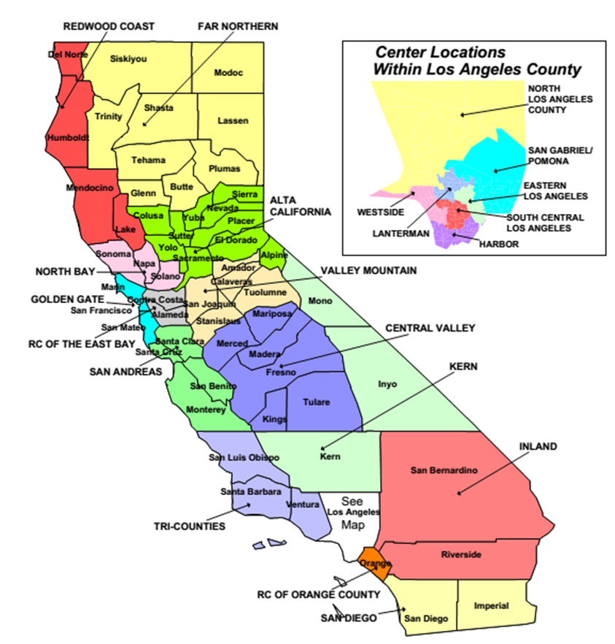
1 / 1
Activity
Details
No Activity Yet
Comment and @mention people to notify them.
PW
Comment(optional)
Write a comment
@mention users to notify them.
Notes:
There are 21 Regional Centers throughout CA

Slide 4
Definition of Developmental Disability per WIC 4512
Originates prior to age 18
Constitutes substantial disability
Includes: Intellectual Disability, Cerebral Palsy, Epilepsy, Autism, 5th Category
Notes:
“Developmental disability” means a disability that originates before an individual attains 18 years of age, continues, or can be expected to continue, indefinitely, and constitutes a substantial disability for that individual. As defined by the Director of Developmental Services, in consultation with the Superintendent of Public Instruction, this term shall include intellectual disability, cerebral palsy, epilepsy, and autism. This term shall also include disabling conditions found to be closely related to intellectual disability or to require treatment similar to that required for individuals with an intellectual disability, but shall not include other handicapping conditions that are solely physical in nature.
(2) (A) If a child who is three or four years of age is not otherwise eligible for regional center services pursuant to paragraph (1), the child shall be provisionally eligible for regional center services if the child has a disability that is not solely physical in nature and has significant functional limitations in at least two of the following areas of major life activity, as determined by a regional center and as appropriate to the age of the child

Slide 5
Definition Continued per Title 17 section 54000
Cannot be solely psychiatric in nature
Cannot be solely physical in nature
Cannot be solely learning disabilities
Notes:
c) Developmental Disability shall not include handicapping conditions that are:
(1) Solely psychiatric disorders where there is impaired intellectual or social functioning which originated as a result of the psychiatric disorder or treatment given for such a disorder. Such psychiatric disorders include psycho-social deprivation and/or psychosis, severe neurosis or personality disorders even where social and intellectual functioning have become seriously impaired as an integral manifestation of the disorder.
(2) Solely learning disabilities. A learning disability is a condition which manifests as a significant discrepancy between estimated cognitive potential and actual level of educational performance and which is not a result of generalized mental retardation, educational or psycho-social deprivation, psychiatric disorder, or sensory loss.
(3) Solely physical in nature. These conditions include congenital anomalies or conditions acquired through disease, accident, or faulty development which are not associated with a neurological impairment that results in a need for treatment similar to that required for mental retardation.

Slide 6
Early Start Services
Early Start is California’s response to federal legislation ensuring that services to eligible infants and toddlers are coordinated and family-centered. It is a statewide system of early intervention services for infants and toddlers from birth to 36 months of age. This program is coordinated by regional centers and public school districts.

Slide 7
School Age & Adult Services
Start at age 3+
Services are funded through the Individualized Program Plan (IPP)
Funder of last resort
TCRC services available to children
How are these services different than adult services
Notes:
Following the intake process and if a decision is made for TCRC services, they can begin as early as age 3 and go through the entire life span of a person
Regional Center funded services are developed through the planning team which include the child/parent or conservator, the assigned Service Coordinator, and is intended to support the child to remain in their family home and in being part of their community.
Services are not provided at the same time as a child would be in school (preschool, middle, high, post secondary)
Children vs. Adult Services
Children’s services funded through both the IEP and the IPP
Adult services begin after the child receives a HS diploma or a certificate of completion per regulation 4648

Slide 8
How to Refer:
Our website: www.tri-counties.org
SLO County: (805) 543-2833
Northern SB County: (805) 922-4640
Please include name, date of birth, information about concerns and any diagnostic information

Slide 9
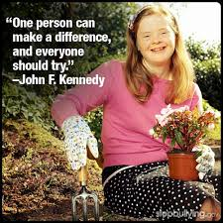
Thank you!
Notes:
Spaced the bulleted items

