Slide 1

SLO County Behavioral Health Access and Crisis Services Division June 18, 2025

Slide 2
Program Updates: Access and Crisis Services Division
Samantha Parker, LCSW, Division Manager
Access and Crisis Services Division
Mobile Crisis and 24/7 Dispatch (SMWG)
BH Community Action Team (CAT)
Crisis Continuum Team (CCT)

Slide 3
Mobile Crisis Response Team July 1, 2024 – March 31, 2025
# of MCRT Responses Per Month
Approx. 600 MCRT Responses (2.2 per day)
Ages of clients served: ages 6 to 90 (average 37.8)
Average arrival time: 34 minutes
Average face-to-face time: 112 minutes
Field calls to BH dispatch: 1,045
Majority (58%) of calls from Central Coast Hotline
4% from law enforcement; remaining from family/self/clinic/therapist/other
*Dec. had highest # of responses to date
Approx. 60% Medi-Cal insured
Notes:
Average arrival time goal: 30 mins
Med-Cal: Target: 3 Medi-Cal responses per day

Slide 4
MCRT Implementation Data July 1, 2024 – March 31, 2025
54%
N=600
Notes:
Face to face average is 112 mins, includes safety plan & resources

Slide 5
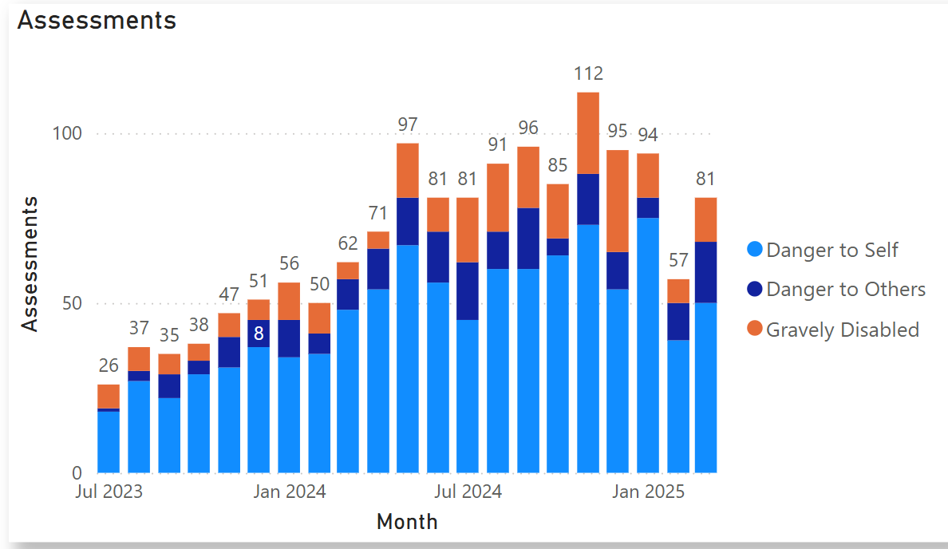
MCRT Assessments
An average of 2.93 MCRT responses per day
34 minutes average response time

Slide 6

Behavioral Health Community Action Team
Law Enforcement and Behavioral Health Co-Response Model
Proactive, preventive approach to support law enforcement’s response to behavioral health crises
Divert individuals from arrest and booking
Collaboration with medical hospitals, street outreach teams, community service organizations
Bringing the clinic to the streets

Slide 7
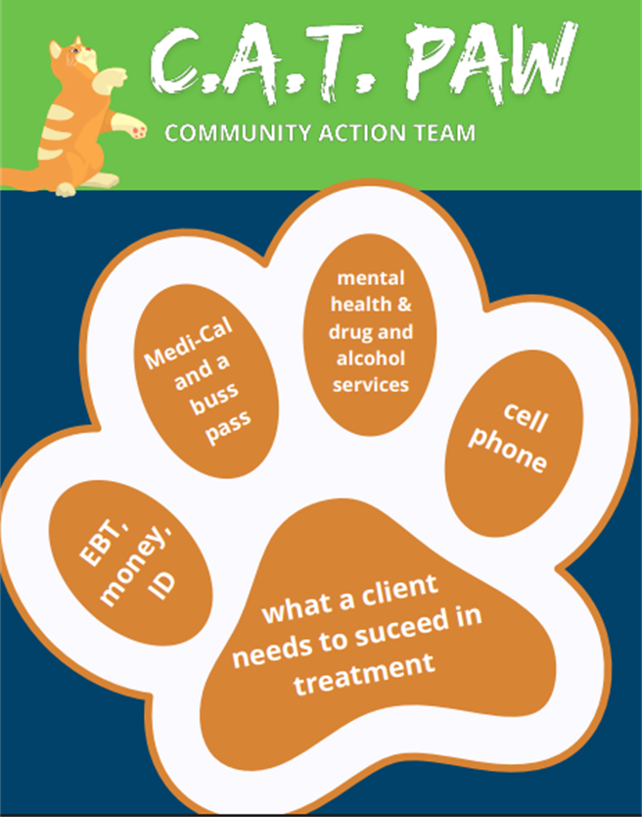
BH CAT: Current Partnerships
Paso PD
Atascadero PD
SLO Sheriff
SLO PD
SLO FD MCU
The public can call the non-emergency
dispatch number and request CAT assistance

Slide 8

BH CAT Outreach and Engagement
July 2024 through April 2025:
Provided 710 encounters
Ongoing Intervention: 470 Clients
Referrals / Case Management: 908
Transportation given for Med Clearance & Case Management: 176
Medication Administered in the field: 39
5150 Evals performed: 133

Slide 9
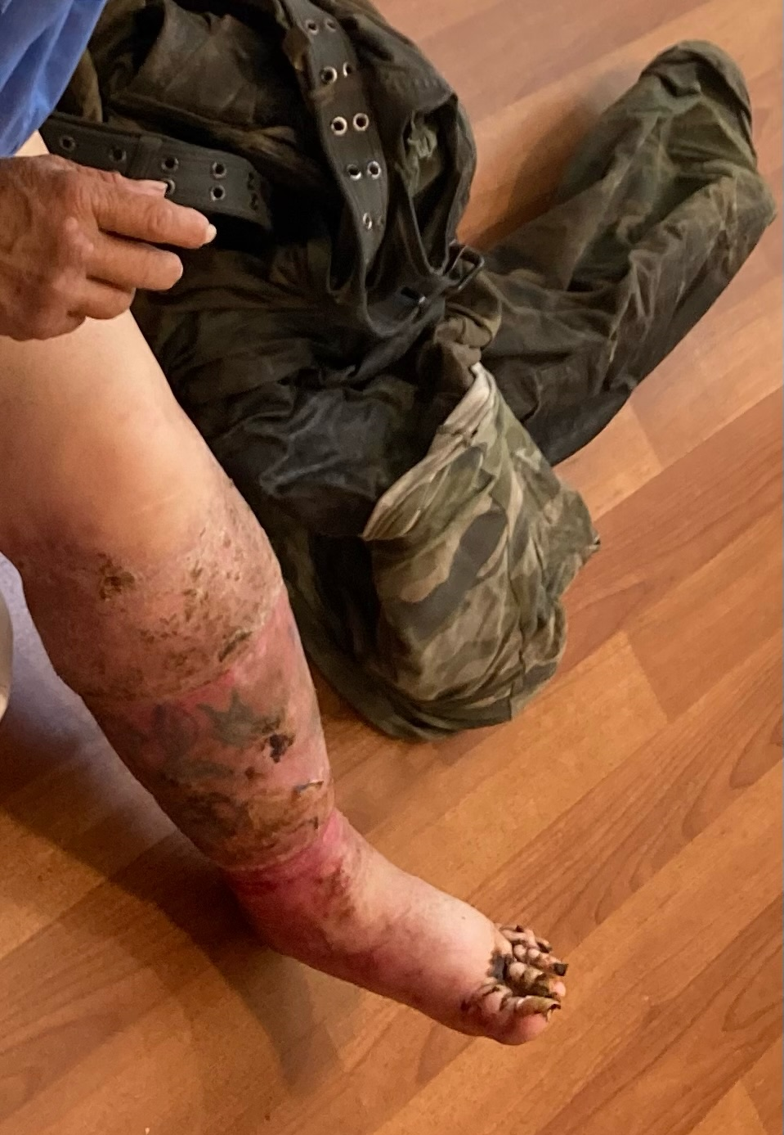
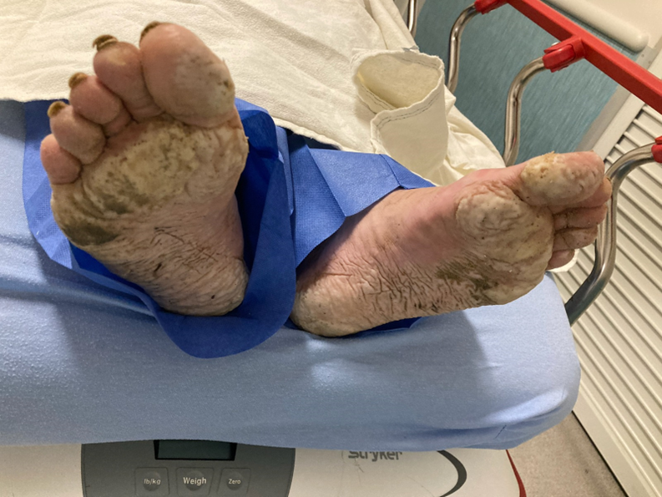

Slide 10

Crisis Continuum Team (CCT)
Staffed 7 days/week, during business hours
Close collaboration with:
SMWG Dispatch and MCRT
BH CAT
Medical Hospitals
Crestwood and Out of County Psychiatric Hospitals
MH & DAS Treatment Teams
Public Guardian

Slide 11
ACSD Contacts
Samantha Parker, LCSW, Division Manager
sparker@co.slo.ca.us
Karina Silva Garcia, PhD, Program Manager
ksilvagarcia@co.slo.ca.us
Samantha Collins, Program Supervisor
scollins@co.slo.ca.us

