Slide 1
New Business: Update on Strategic Plan
August 2025

Slide 2
BHD Strategic Plan
Gaps Analysis: Youth Services
Gaps Analysis: Adult Services
BHD Strategic Plan (five years 2024 – 2029)
KPMG Report: Efficiency Recommendations
Synthesis Report
Services along the continuum of care
Prevention Wellness, Outpatient Services, Community Services, Crisis Services, Intensive Residential Services
Five areas with four goals each

Slide 3
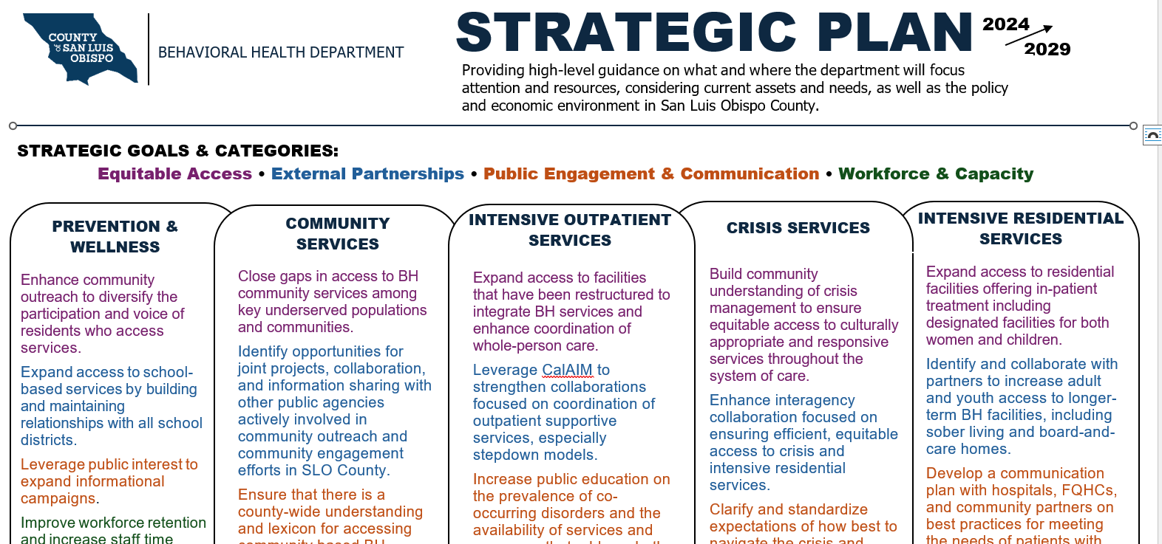
Year 1 Goals: See handout

Slide 4
Accomplishments: See handout
19/20 goals achieved in the first year = 95%
Initiative: Beds, Beds, Beds
Integration: Co-location, integration mental health and substance use treatment services, integration behavioral health with public health (Martha’s Place and primary prevention such as campaigns)

Slide 5
Administrator Report: Budget Status FY2025-26
August 2025

Slide 6
FY 2025-26 Budget – Quick Review
$10 million reduction list for General Fund Support
33 FTE positions eliminated (number of staff 319 down to 286)
Reassignments, promotions, opportunities
Hiring and Chill process now
Current vacancy rate: 16% (46 positions)

Slide 7
Timeline
Effective July 1, new changes:
DAS to Hospital Way (7-1-2025) Integration efforts
MHET (10-1-2025)
Martha’s Place Sustainability Plan (12-1-2025)
Increase Revenue (grants, rates, partnerships)
Medi-Cal Productivity (10-1-2025)

Slide 8
Specific Integration Plans
  Drug and Alcohol Services Atascadero clinic closure (move to Hospital Way/PR Health Campus) – Resumed July 7 in new location. Licensed for DMC-ODS. Continue remodel efforts for more services.
  Youth mental health services – ‘Katie A’ transition to Family Care Network.
  Adult mental health services – Paso Robles and Atascadero Campus Models.
  Substance Use Disorder Youth Treatment services move to the Youth Services Division (under Jill Rietjens and Lynley Ewen). Expect COD services.
  Veteran’s Treatment Court services move to the Justice Services Division (under Joshua Woodbury).
  MAT Services integration with Crisis Services/CAT teams. Homeless Services Outreach at Prado beginning September. Mobile van for Post-PHF services.
Notes:
Youth mental health services (Katie A transition to Family Care Network)
Adult mental health services – Paso Robles & Atascadero Campus Model. Wilshire
Substance Use Disorder Youth Treatment services move to the Youth Services Division (under Jill Rietjens and Lynley Ewens). Expectation for COD services.
Veteran’s Treatment Court services move to the Justice Services Division (under Joshua Woodbury).
MAT Services with Crisis Services/CAT team.

Slide 9
MHET Services (10-1-2025)
MHET vs. MCRT
Hospital Services to continue at last minute due to revenue agreement with all 4 hospitals for three months (pass through to Sierra Mental Wellness Group).
Effective 10-1-2025, Dignity hospitals will have their own staff who can perform 5150 (as designated by the County).
Holds still to be processed and worked through the current Dispatch and CCT teams. 2275 Process is still in place with the County responsibility for hearings at hospital.
After 10-1-2025 Memorandum of Understanding (MOU) with all four hospitals for roles and responsibilities.

Slide 10
Martha’s Place (12-31-2025)
Bi-monthly meetings with BHD and PH to discuss reduction on General Fund Support and develop a written Sustainability Plan
Involves discussion of Screening, Assessment processes (reduce barriers and gaps) to increase referrals
Involves discussion of roles and responsibilities of MP staff
Involves research on other different models
Community Stakeholder meeting on Friday 8/22
Reorganization, Partnerships, and Increasing Revenue

Slide 11
More Revenue Next Steps (until 7-1-2029)
Medi-Cal Maximization Training Initiative (MMTI)
Incentive payments and invoicing – technical assistance
Bundled rates for programs – with requirements
Implementation of Evidence Based Practices (EBPs)
Re-evaluate SLO County reimbursement rates (Medi-Medi Clients in January 2026)

Slide 12
Productivity (begins 10-1-2025)
What is the Why?
Client Care Standards Memo for definitions
45% baseline to 60% goal
Direct client hours per week, intensity of services
Reimbursable and non-reimbursable (travel and documentation tracking)
Holidays for all
Individual Plans/Carve Outs
Weekly meetings with Supervisor
Clinical Care Report (new dashboard for staff)
Notes:
Why? To reduce reliance on General Fund Support (County funding). To increase our own services/personnel and our own budget impacts ( take care of ourselves ). To increase intensity and integration of services – MH and SUD staff helping each other, crossing silos to increase quality care for clients.
Other Tools –
Financial Tools related to billing, disallowances, and revenue
Budget projections by Clinic, Programs
Profit and Loss Statements for clinics and/or programs on a regular quarterly or bi-annual basis
Performance Measures

Slide 13
Questions and Discussion
Notes:
Continue the dialog, continue the revisions of the report to be helpful.
Continue communication and feedback.

