Slide 1


WELCOME
22ND ANNUAL COMMUNITY ADVISORY COUNCIL ORIENTATION
2025
P&B
2025

Slide 2

COMMUNITY INVOLVEMENT
“Community is much more than belonging to something; it’s about doing something together that makes belonging matter.”
-Brian Solis, Author
P&B

Slide 3
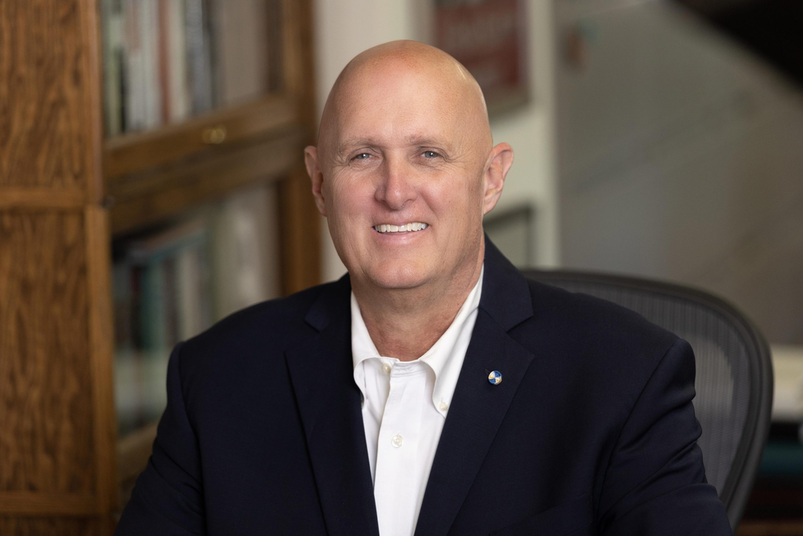
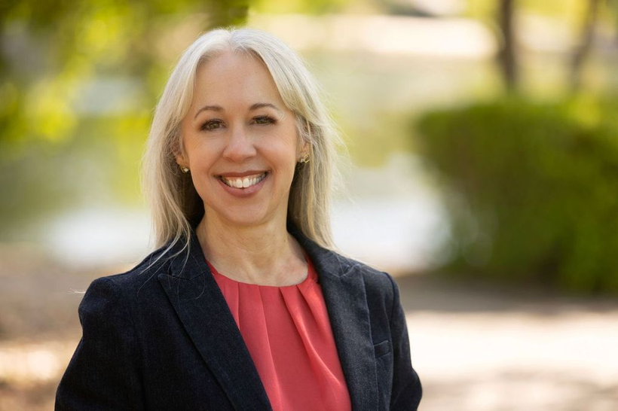

HONORABLE GUEST SPEAKERS
John Peschong, District 1
Heather Moreno, District 5
Mariam Shah, PC Chair
County Board of Supervisors & Planning Commission
P&B
2025

Slide 4
CAC OVERVIEW
P&B
2025

Slide 5
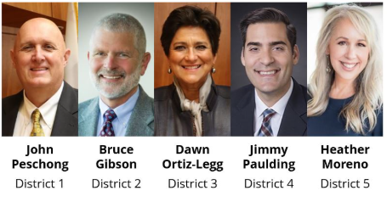
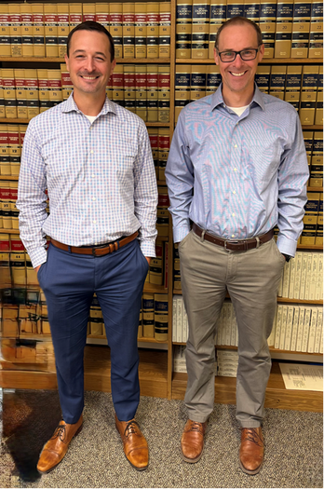
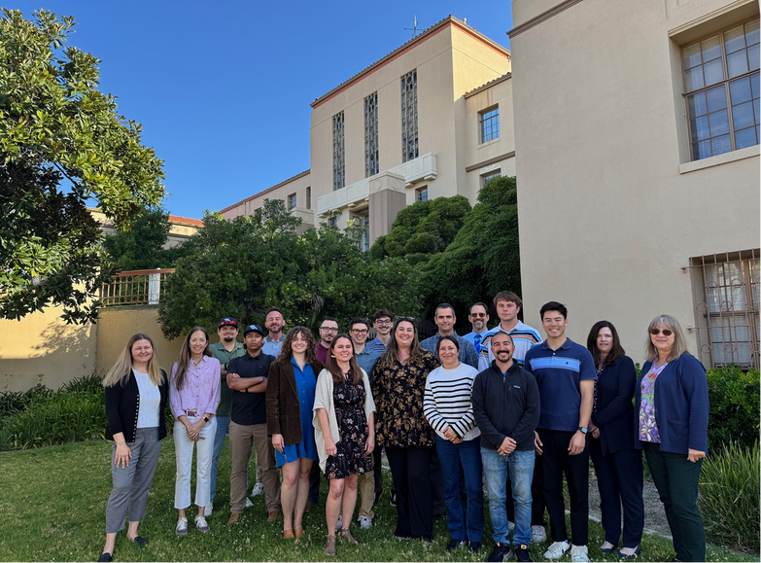
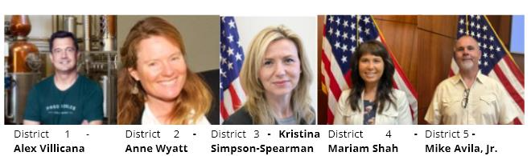
CAC MEMBER ORIENTATION
Board of Supervisors
Planning Commission
County Counsel
County Staff
Recognition and Oversight of CAC’s
Project Review and Decision Makers
Legal Requirements
Land Use Planning & Referrals
The Board of Supervisors has recognized eleven Community Advisory Councils (CACs), made up of resident volunteers who represent their community's interests in the County planning process.
The Planning Commission, a five-member body appointed by the Board of Supervisors, reviews land use decisions in the County. It has authority over tract maps, conditional use permits, and variances, and makes recommendations to the Board on plan and ordinance updates.
The County Counsel's Office provides legal advice and representation to County departments, agencies, and districts, supporting policy innovation and promoting excellence, civility, and integrity in government services.
The Department of Planning and Building oversees San Luis Obispo County's unincorporated areas, handling land use planning, policies, programs, permitting, environmental review, and zoning enforcement to promote safe, sustainable communities.
P&B

Slide 6

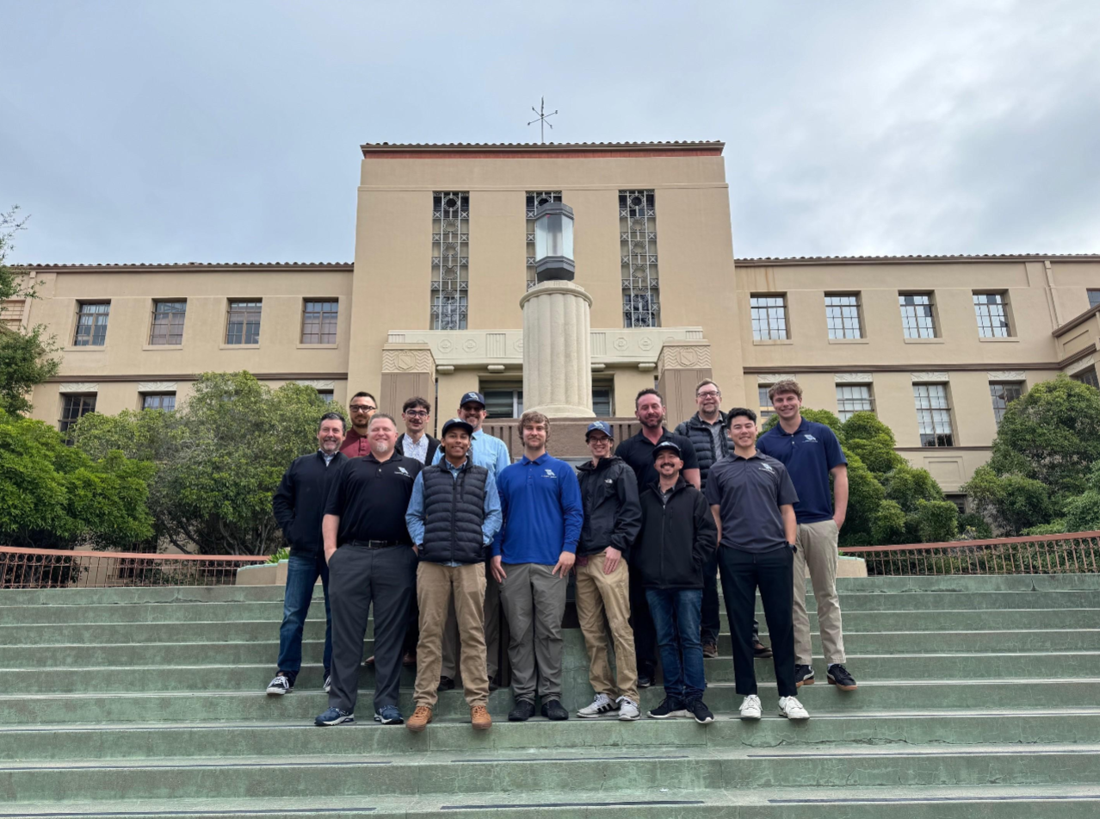
THE P&B LIAISON TEAM
Liaisons play an integral role in bridging our unincorporated communities’ input on local planning decisions. Their role is to foster a productive relationship between the CAC and the County
at their monthly meetings by guiding the discussions around responsible
land use processing and fostering informed project recommendations.

Slide 7
COUNTY COUNSEL DISCUSSION
P&B

Slide 8

Planning and Zoning Law
Derived by the police power established in the State Constitution:
“A county or city may make and enforce within its limits all local, police, sanitary, and other ordinances and regulations not in conflict with general laws.” Cal. Const. at. XI, section 7.
“The police power is not confined to elimination of filth, stench and unhealthy places. It is ample to lay out zones where family values, youth values, and the blessings of quiet seclusion and clean air make the area a sanctuary for people.”
Village of Belle Terre v. Boraas, (1974) 416 U.S. 1
P&B

Slide 9



…not in conflict with general laws?
A conflict exists between a local ordinance and state law if the ordinance “duplicates, contradicts or enters an area fully occupied by general law, either expressly or by legislative implication.” Viacom Outdoor Inc. v. City of Arcata, (2006)140 Cal. App. 4th 230, 236.
P&B

Slide 10
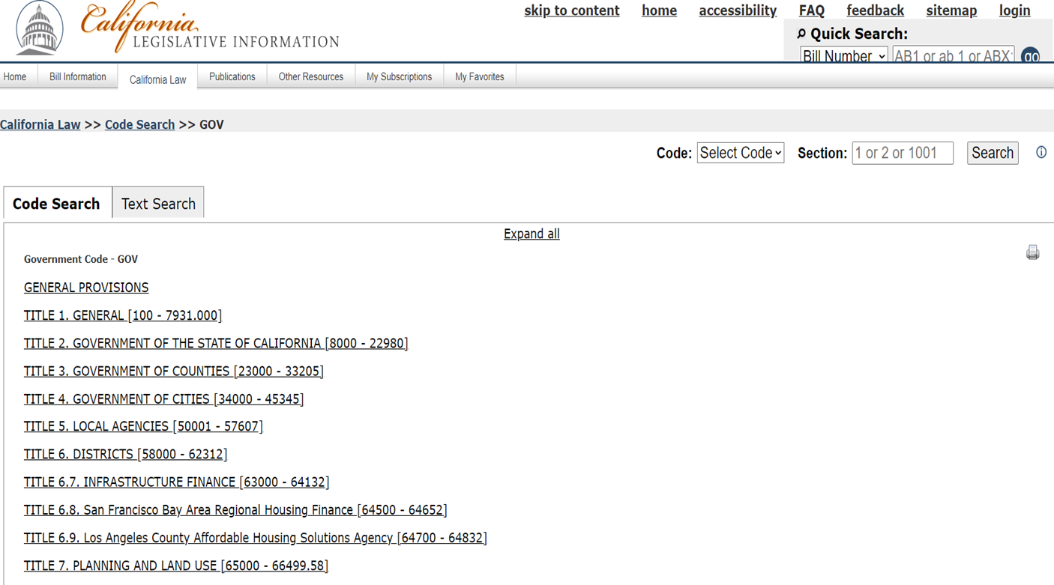
P&B

Slide 11
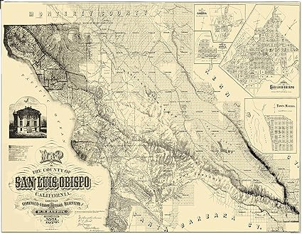
Planning and Zoning Law
(Gov. Code 65000-66035)
•Creates the State Office of Planning and Research
•Establishes rules regarding planning by local agencies
•Requires the establishment of the General Plan with 7 mandatory elements
•Establishes rules regarding Specific Plans
•Establishes rules government zoning regulations and the requirement to have a planning commission.
P&B

Slide 12

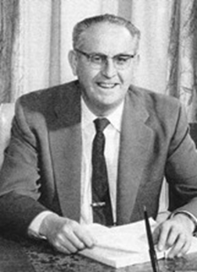
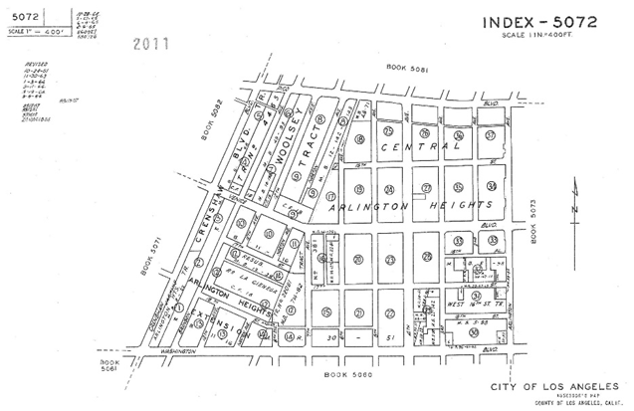

Other State Laws to Consider Include the...
Subdivision Map Act
(Gov Code 66410-66499.58)
California Environmental Quality Act (Pub. Res. Code 21000-21189.3) and
CEQA Guidelines (14 CCR 15000-15387)
Ralph M. Brown Act Government Code Sections 54950 – 54963
P&B

Slide 13

Quasi-Legislative v.
Quasi-Judicial Decision Making
Are we Making Law (Legislative)?; or
Are we Applying Facts (a Development Project) to a
Set of Laws?
Judicial review of quasi-legislative acts is usually limited to determining whether the act was arbitrary or capricious; the act was entirely lacking in evidentiary support; or the agency failed to follow the procedures required by law.
“Abuse of discretion” is established when: the agency has not proceeded in the manner required by law; the order or decision is not supported by the findings; or the findings are not supported by the evidence.
P&B

Slide 14

Vested Rights
If a property owner has received a permit from a public agency to do something, such as a building permit or use permit, and then incurs substantial costs in reliance of that permit, then the property owner has the right to rely on that permit regardless of changes in the public agency’s land use regulations.
Avco Community Developers, Inc. v South Coast Reg'l Comm'n (1976) 17 C3d 785, 793.
P&B

Slide 15
CAC HANDBOOK OVERVIEW & DISCUSSION
P&B

Slide 16
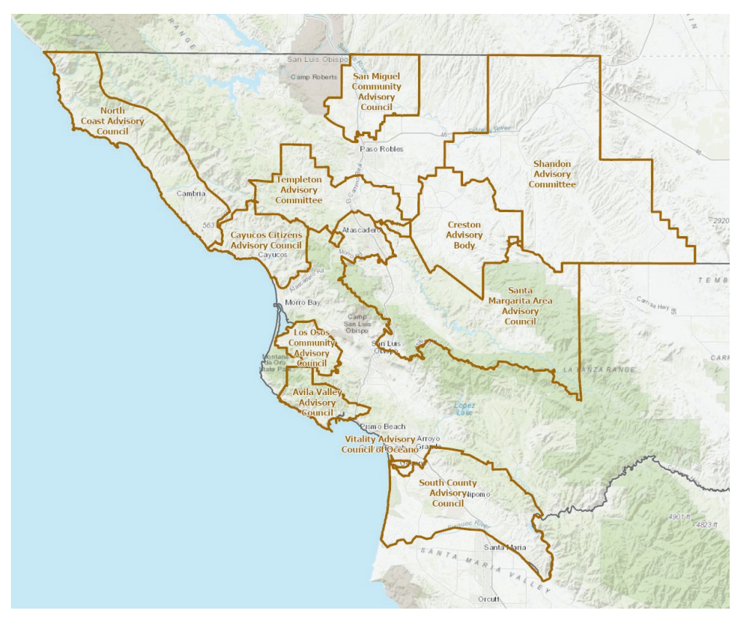
COUNTY OF SAN LUIS OBISPO
COMMUNITY ADVISORY COUNCIL MAP
P&B

Slide 17
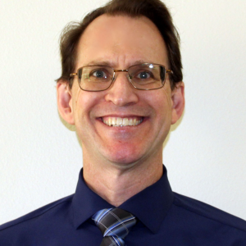
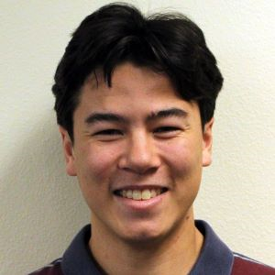

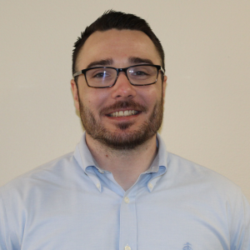
Meet your CAC Liaisons
Avila Valley
Advisory Council
(AVAC)
Cayucos Citizens
Advisory Council
(CCAC)
Creston Advisory Body
(CAB)
Los Osos Community Advisory Council
(LOCAC)
Jeremy Freund
Andy Knighton
Dominic Dal Porto
Mason Denning
Jeremy started with the County in 2023. He is a part of the Inland Rural Subdivision Division and a subject matter expert on Land Division Projects.
Andy started with the County in 2022. He is part of the Coastal Team and oversees Land Use Projects in the Cayucos Area.
Dominic started with the County in 2023. He is part of the Long-Range Team. He oversees the Surface Mining Inspection Program and Water Conservation Programs.
Mason started with the County in 2023. Mason started in the Environmental Team and is now part of the Coastal Team. He oversees Land Use projects in Los Osos and supports the Coastal Team.
P&B

Slide 18
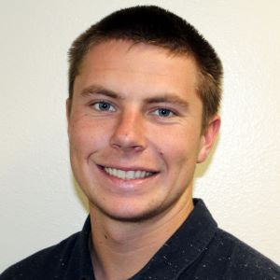

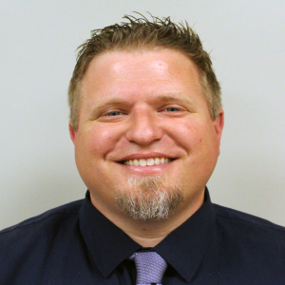

Meet your CAC Liaisons
North Coast Advisory Council (NCAC)
San Miguel Advisory Council (SMAC)
Santa Margarita Area Advisory Council (SMAAC)
Shandon Advisory Council (SAC)
Dane Mueller
Tristan Roach
Eric Hughes (temp)
Blake Maule
Dane started at the County as an intern for the Planning team, supporting Coastal and Inland. He began his career as an intern and joined the Coastal team in 2023. He now overseas projects in the Oceano, Estero, and Cambria Area.
Tristan started at the County as an intern on the Long-Range team and began working as a Planner in 2024. He has worked on a variety of projects including the Los Osos Habitat Conservation Plan (LOHCP) and Housing Element implementation actions.
Eric has worked at the County for approximately 7 years cumulatively. His role has spanned from Intern with the Environmental Division to his current position as the Current Planning Division Manager.
Blake started with the County in 2022. He is a Planner on the Urban and Special Projects Team and specializes in Environmental Review and Determination of Conformity Reports.
P&B

Slide 19
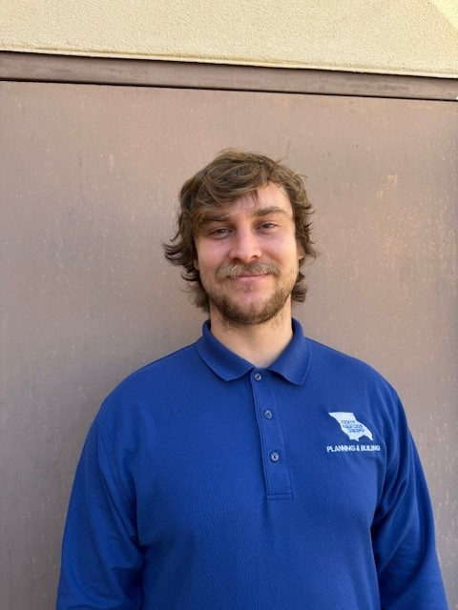
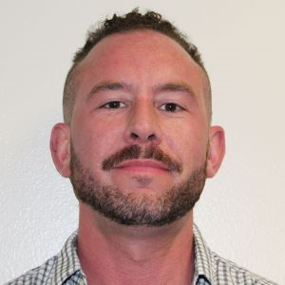
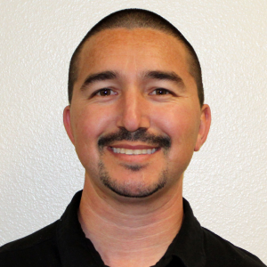
Meet your CAC Liaisons
South County Advisory Council (SCAC)
Templeton Area Advisory Group
(TAAG)
Vitality Advisory Council of Oceano (VACO)
Lane Sutherland
Eric Tolle
Michael Zapeda
Lane started his career with the County as a Public Works intern in 2019. He transitioned to Planning and Building in 2020. He is part of the Complex Inland Rural Communities and Subdivisions Team.
Eric started with the County in 2022. He is part of the Complex Inland Projects and Subdivisions Team. He also serves as the Airport Land Use Commission Liaison and acts as the Point of Contact for all CAC Liaisons.
Michael started with the County in 2022. He is part of the Permit Center Planning Team and specializes in Tree Removal Permits, Zoning Clearances, and helping the public with inquiries.
P&B

Slide 20
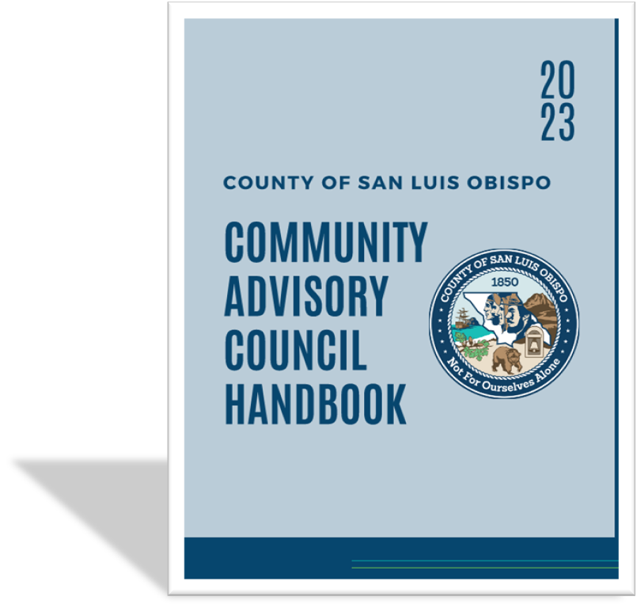
CAC Handbook:
P&B

Slide 21





CAC By-Laws Guidelines:
Mission Statement
Membership
Meetings
Voting & Decision-Making
P&B

Slide 22

Overview of Roles
ADVISORY COUNCIL
SLO COUNTY
Receive referral package from Planning and Building Department and complete recommendation form, if applicable. Add project discussion to the next advisory council meeting agenda.
Receive agenda and recommendation form from advisory council. Add advisory council as interested party and attach comments to project packet.
Expected to make a recommendation within the required 60-day timeframe, upon receipt of the first iteration of a project. If re-referred, council has
45-days to review and submit additional comments.
If the project is substantially modified after the advisory council’s review, the Planning and Building Department may re-refer a project to the council for additional comments.
P&B

Slide 23

ADVISORY COUNCIL
SLO COUNTY
Send advisory council meeting agenda and any project questions to the Planning Liaison one week prior to the meeting. For projects requiring other County departments, council will coordinate with District Legislative Assistant.*
Planning Liaison will attend the meeting with prepared responses and additional staff as needed. Planning Liaison will attend one meeting per month, if requested by the advisory council.
It is recommended that planning items be placed toward the beginning of the agenda. Staff presence at advisory council meetings is always subject to staff availability.
When possible, the Planning Liaison will provide updates from the department on other items relevent to their community (i.e. ordinance updates, general plan updates, etc.).
P&B

Slide 24
PLANNING 101: LONG-RANGE PLANNING
P&B

Slide 25





THE GENERAL PLAN
MANDATORY ELEMENTS
OPTIONAL ELEMENTS
“Blueprint”
A policy level visioning-plan that guides decision from a Long-Range Perspective
Land Use
Circulation
Housing
Safety
Noise
Conservation & Open Space
Parks & Recreation
Agriculture
Offshore Energy
Economic
CONSISTENCY
All Elements must be consistent with one another
All Elements of the General Plan have equal status
P&B

Slide 26









General Plan Amendments
Authorization
Referrals
Planning Commission
Board of Supervisors
AMENDMENT
BECOMES
EFFECTIVE
Board of Supervisors Authorizes Staff to Process
Sent to Community Advisory Councils, County Departments, and Other Agencies
Recommendation to Board of Supervisors
Board of Supervisors takes Final Action
P&B

Slide 27

SAN LUIS OBISPO COUNTY
GENERAL PLAN
LAND USE &
CIRCULATION ELEMENT
OTHER ELEMENTS
Conservation & Open Space
INLAND
COASTAL ZONE
LOS OSOS COMMUNITY PLAN
**Not included in the Local Coastal Program
Housing
Framework for Planning
Coastal Zone Framework for Planning
Area Plans
Coastal Plan Policies
Official Maps
Noise
Area Plans
Estero Area Plan
Safety
Community Plans
Non-Mandatory Elements
Official Maps
P&B

Slide 28

Land Use and Circulation Elements
of the General Plan
(Inland)
Framework for Planning (Part I)
Lists Countywide Planning Goals
Provides an Overview of Land Use and Circulation Process
Describes the Purpose & Character of the 13 Land Use Categories
P&B

Slide 29




Land Use and Circulation Elements of the General Plan
(Inland)
Area (Part II) | Sub Area(s) (Part II) | Community/Village (Part III)
Carizzo | N/A | California Valley
North County | Adelaida, El Pomar-Estrella, Las Pilitas, Los Padres (North), Nacimiento, Salinas River | San Miguel, Santa Margarita, Shandon, Templeton, North County Villages
San Luis Obispo | San Luis Obispo (North), San Luis Bay Inland (North) | Los Ranchos/Edna
South County | Huasna-Lopez, Los Padres (South), San Luis Obispo (South), San Luis Bay Inland (South), Shando-Carrizo (South), South County | Nipomo, Oceano, South County Villages
P&B

Slide 30
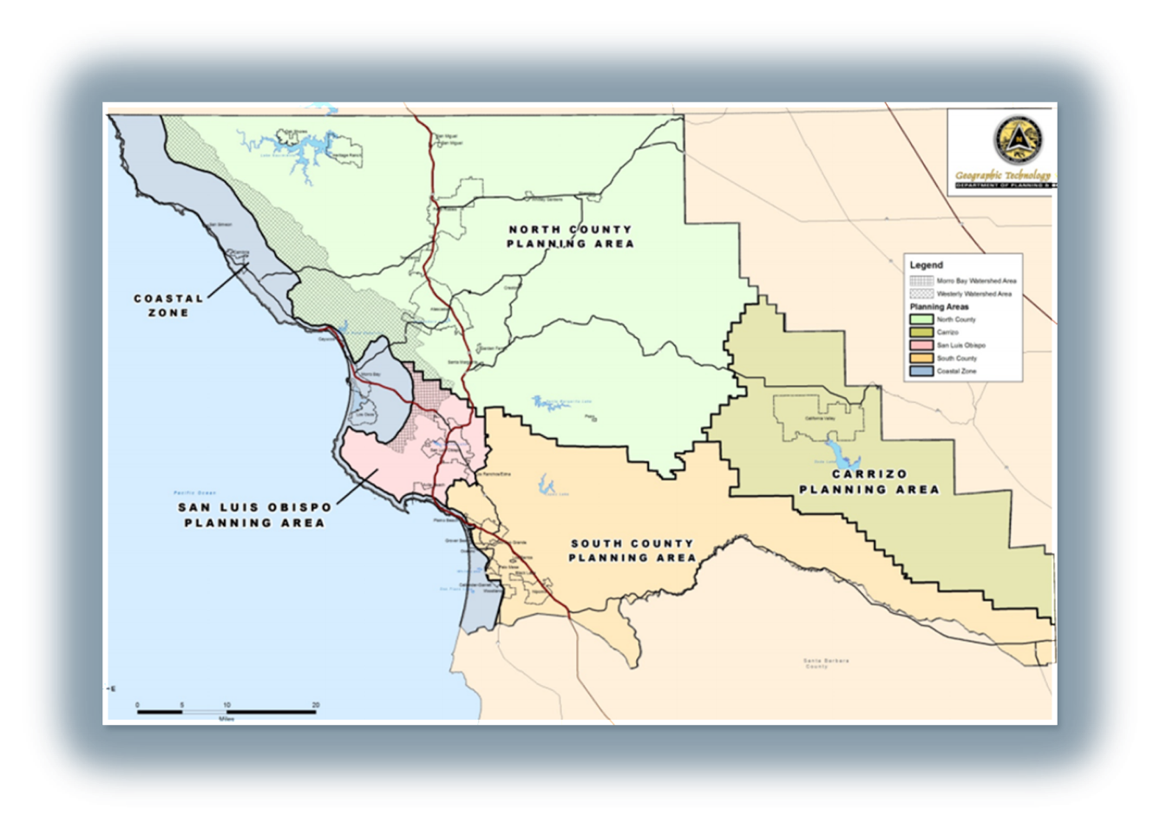
Land Use and Circulation Elements
of the General Plan
(Inland)
Official Maps (Part IV)
P&B

Slide 31


SAN LUIS OBISPO COUNTY
GENERAL PLAN
LAND USE & CIRCULATION ELEMENT
OTHER ELEMENTS
COASTAL ZONE
LOS OSOS COMMUNITY PLAN
Conservation & Open Space
INLAND
**Not included in the Local Coastal Program
Housing
Coastal Zone Framework for Planning
Area Plans
Coastal Plan Policies
Official Maps
Framework for Planning
Noise
Area Plans
PART OF THE LOCAL
COASTAL PROGRAM
Safety
Community Plans
Non-Mandatory Elements
Official Maps
P&B

Slide 32








Land Use and Circulation Elements
of the General Plan
(Coastal)
Area (Part II)
Estero
North Coast
San Luis Obispo (Coastal)
South County (Coastal)
P&B

Slide 33
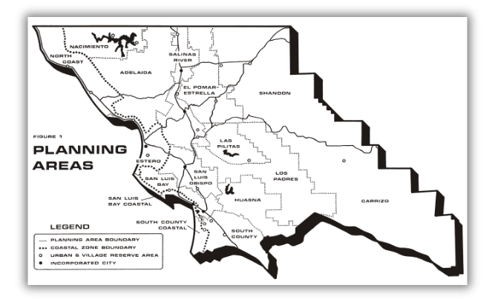
Land Use and Circulation Elements
of the General Plan
(Coastal)
Official Maps (Part III)
P&B

Slide 34







Land Use Ordinance
Implements the General Plan by Regulating Uses
Inland Land Use Ordinance - Title 22
Coastal Zone Land Use Ordinance - Title 23
Land Use Definitions
Allowable Uses
Design
Standards
Operational Standards
Definitions of land uses that describe their purpose and characteristics
If allowed, requirements for approval of development
For example:
Height,
Setbacks,
Parking
For example:
Noise control,
Air quality, Maximum hours
P&B

Slide 35
PLANNING 101: CURRENT PLANNING
P&B

Slide 36






What is your Role in the Planning Process?
MILESTONES OF A PROJECT
Planning Process Overview
Project Referrals
Ministerial vs. Discretionary
Providing Input and Recommendations
P&B

Slide 37








Planning Process Overview
Pre-Application
File Application
Referrals
Staff Review
Public Hearing
Internal Meeting between County Departments and Applicant to Discuss Project Scope and Entitlement Requirements and Process.
Referral Package sent to Community Stakeholders (i.e., County Departments, Referral Agencies, and Community Advisory Groups).
Staff Reviews Complete Application and Provides a Recommendation that Incorporates Referral Comments and Environmental Review.
Public Notice, Public Hearing
and Action,
Appeal Period,
Appeal Hearing
(if applicable) and
Final Action.
Applicant Submits Complete Application Online or at Front Counter.
P&B

Slide 38


Project Referrals
Engaging and Incorporating Information
State and Federal
Community Advisory Councils
Planning Staff
CA Department of Fish and Wildlife, US Department of Fish & Wildlife, Army Corps
11 Advisory Councils Throughout the County
Coastal
(if applicable)
County Departments
California Coastal Commission
Public Works, Building, Environmental Health, &
Ag Commissioners
Agencies
Cal Fire, Cal Trans
P&B

Slide 39

Ministerial vs. Discretionary
Ministerial
Discretionary
Review for Compliance with Land Use &
Building Regulations
YES
YES
CEQA -
Environmental Review
NO
YES
Referred to
Community Advisory Council’s
NO
YES
Decision made by a
Public Hearing Body
NO
YES
Building Permit, Site Plan, Zoning Clearance, &
Business Licenses
Land Use Permits, Conditional Use Permit, Minor Use Permit, General Plan Amendment, Land Divisions
Project Types
P&B

Slide 40


Ministerial Flow Chart
Approval
Staff Review for Consistency with Established Criteria
Project Application
Denial
P&B

Slide 41

Project Application
Discretionary Flow Chart
Referrals sent to Advisory Councils
Referrals sent to Internal Review Agencies
Planning Staff Review of Project
Resubmittal Requirements/Information Request
Approval
Staff receives Referral Comments and either requires Resubmittal Criteria or Provides an Approval Letter
Application Deemed Accepted for Processing
Staff prepares Hearing Materials / Environmental Materials
Denial
Public Hearing
P&B

Slide 42
Providing Input & Recommendations
•Input should be Provided within 60 days of Initial Referral Packet and 45 days for Re-Referrals.
•Planning and Building has created a Standard Comment Form for Advisory Council to Utilize.
•It is the responsibility of the Advisory Council to Communicate with Project Applicants and Staff to Provide Advanced Notice before they Review a Project so that they may Attend Respective Meetings.
•The Advisory Council should Request to be Notified of Future Public Hearings on Projects as an Interested Party.
P&B

Slide 43
PLANNING 101: CEQA
P&B

Slide 44




California Environmental Quality Act
Purpose of CEQA
County CEQA Guidelines
County Environmental Review Process
Environmental Issues
P&B

Slide 45






BASIC PURPOSE OF CEQA
Disclose Information
Identify ways to avoid the impacts
Consider Mitigation and Alternatives
Enhance Public Participation
Foster Interagency Cooperation
P&B

Slide 46
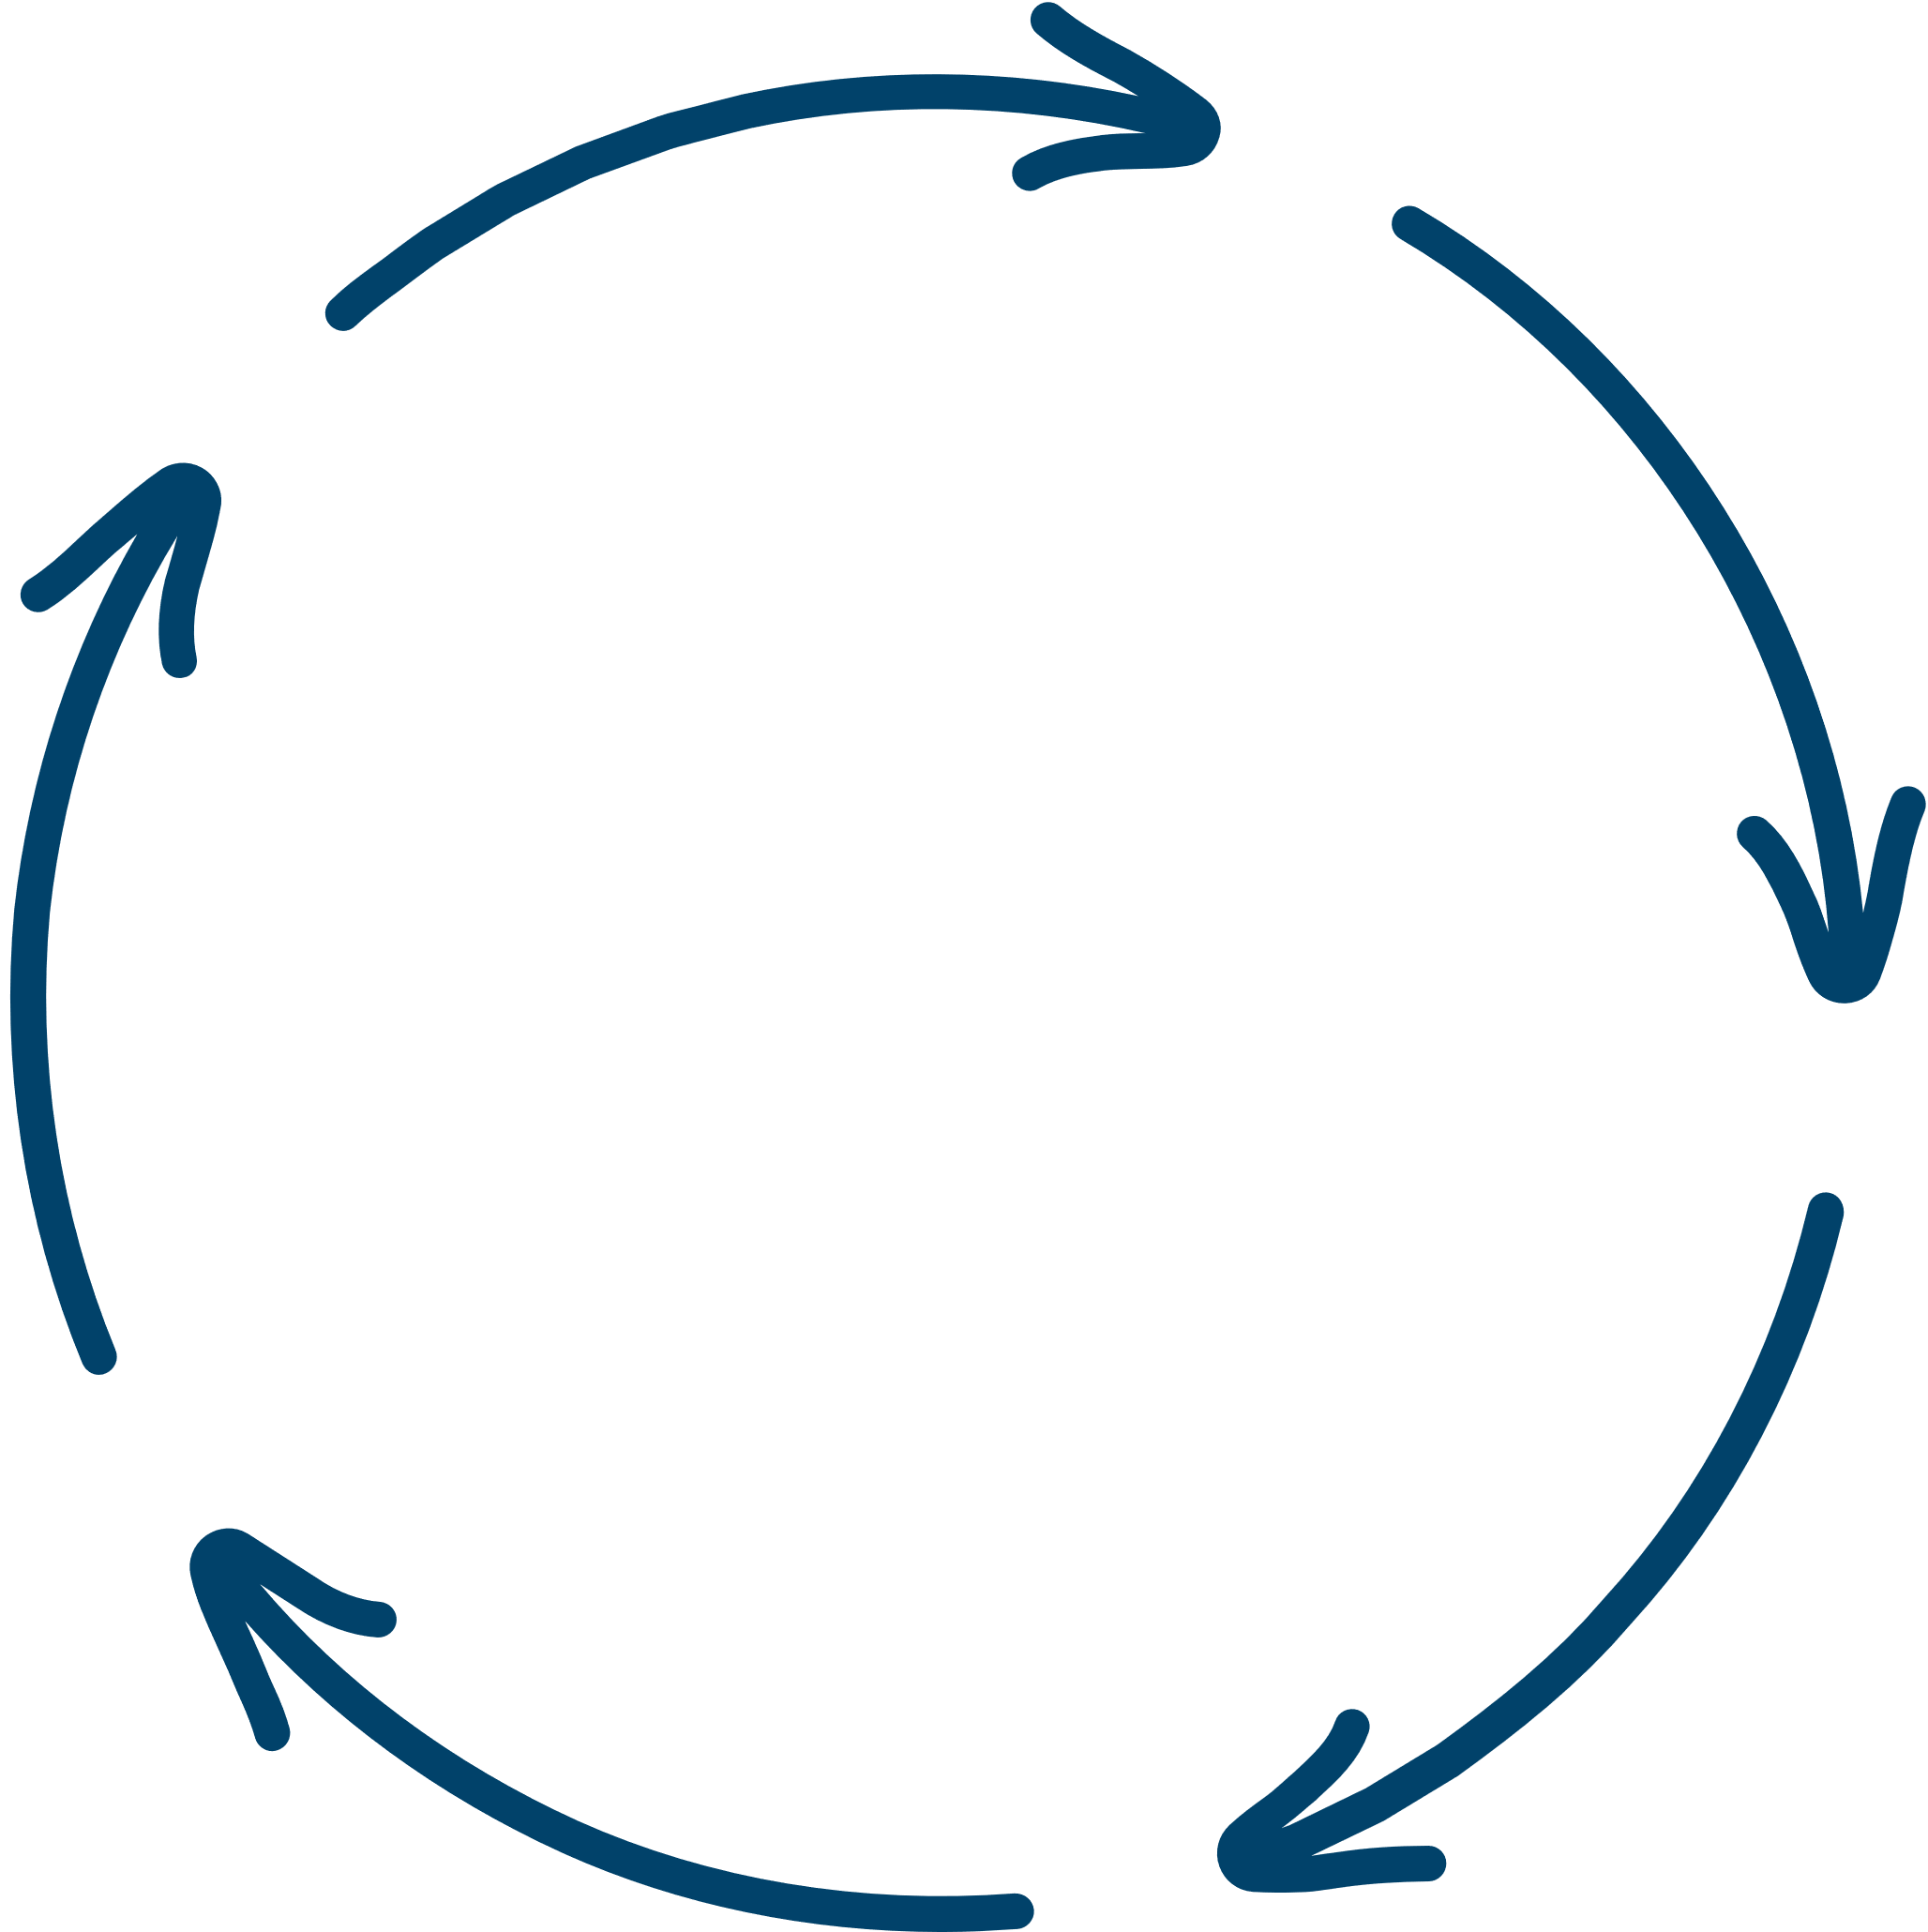




COUNTY CEQA GUIDELINES
Definitions, Procedures, Criteria and Objectives for Implementing CEQA
Facilitate County compliance with CEQA, Standardize Procedures for the Evaluation of Projects, and Preparation of Environmental Documents when the County is the Lead, Responsible, or Reviewing Agency under CEQA.
Adopted by BOS
Assure Compliance with State Law
Standardize CEQA Procedures
Implement CEQA
Ensure Public Participation
P&B

Slide 47


COUNTY ENVIRONMENTAL REVIEW PROCESS
Preliminary Review
Exempt
Initial Study
Environmental Determination
Negative Declaration
Environmental Impact Report
Public Review
Approval
P&B

Slide 48







ENVIRONMENTAL ISSUES
Initial Study Checklist
Aesthetics
Greenhouse Gas Emissions
Public Services
Agriculture and Forestry Resources
Hazardous / Hazardous Materials
Recreation
Air Quality
Hydrology / Water Quality
Transportation
Biological Resources
Land Use
Tribal Cultural Resources
Cultural Resources
Mineral Resources
Utilities / Service Systems
Energy
Noise
Wildfire
Geology / Soils
Population / Housing
Mandatory Findings of Significance
P&B

Slide 49
PURVIEW OF PUBLIC WORKS
P&B

Slide 50









What does Public Works Review?
Access and Right-of-Way Issues
Roadway Capacity and Traffic Operations
Public Improvements/CGSW
Flood Control (FEMA)
Stormwater (SWB)
Drainage
Subdivisions, Use Permits, Construction Permits
What Level of Detail is Needed for Review?
Varies with Entitlements vs. Construction Permits
P&B

Slide 51
AVAILABLE RESOURCES: DEPT WEBSITE / PERMITSLO
P&B

Slide 52



RESOURCES AT YOUR FINGERTIPS
Department Website
LandUse View
Permit SLO
P&B

Slide 53
REFERRAL PROCESS 101
P&B

Slide 54

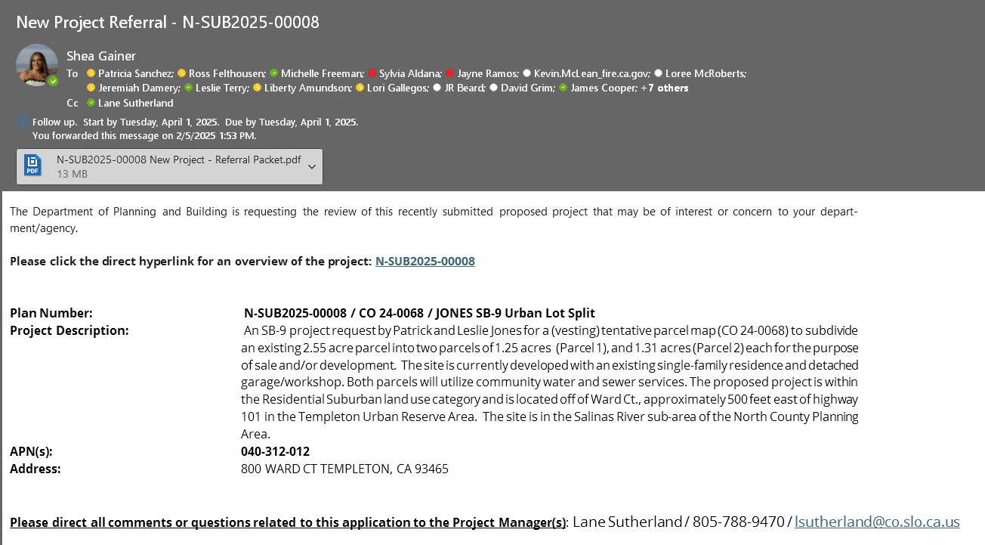
Referral Project - Email Example
P&B

Slide 55
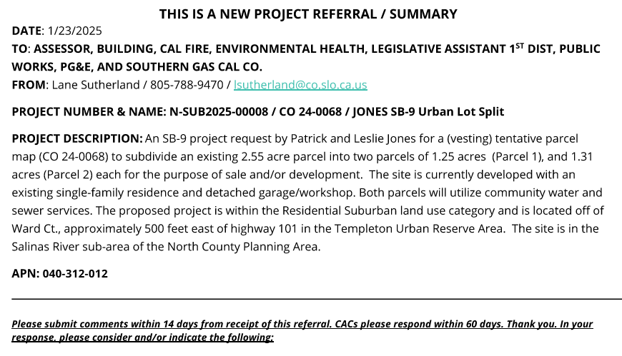

Referral Packet Cover Page
P&B

Slide 56
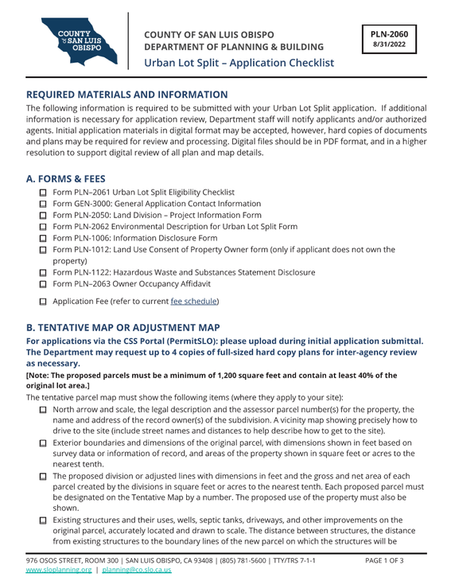
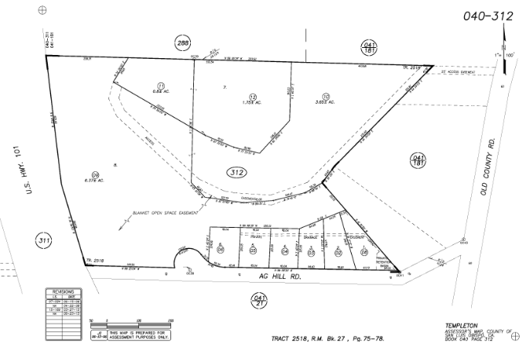
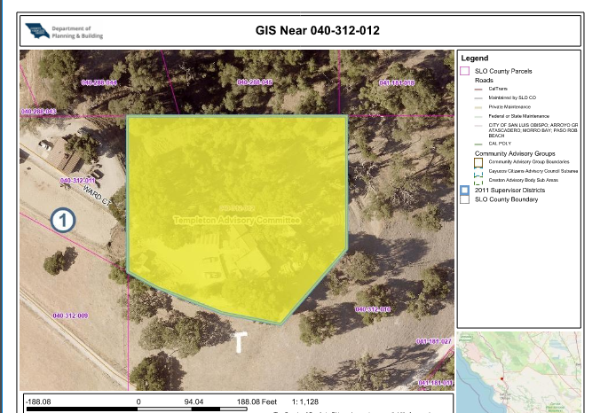
What does a Referral Packet Include?
Land Use Application
Supporting Documents
Parcel Report
GIS Aerial
Assessor Parcel Maps
P&B

Slide 57


CAC Standard Comment Form Overview
CAC Standard Comment Form
P&B

Slide 58

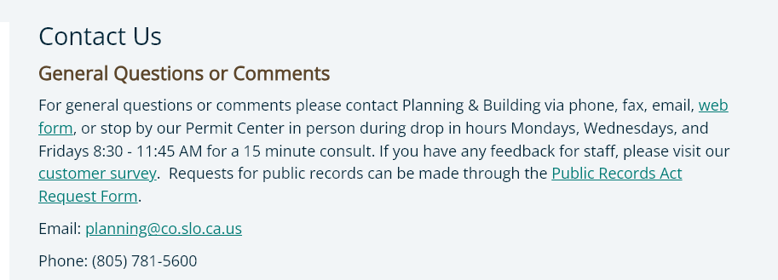
What is the Best Way to Contact Us ?
Reach out Directly to the Project Manager listed on the Cover Page
Use the ‘Contact Us’ page on the Department Website
P&B

Slide 59
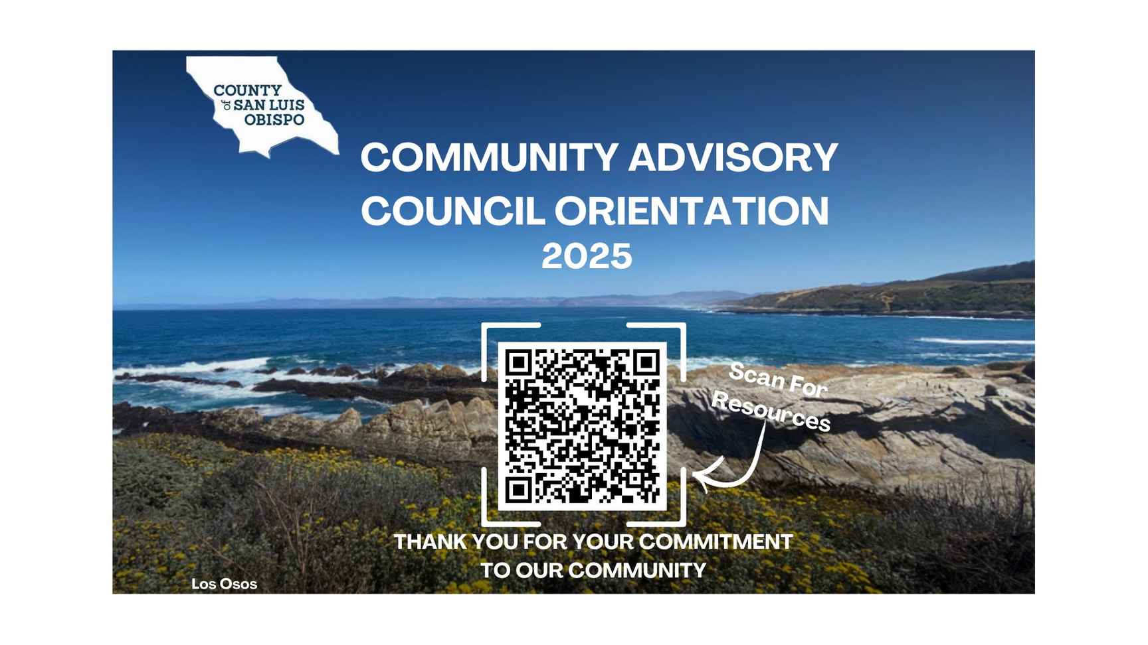
Community Advisory Council Resources
P&B

Slide 60
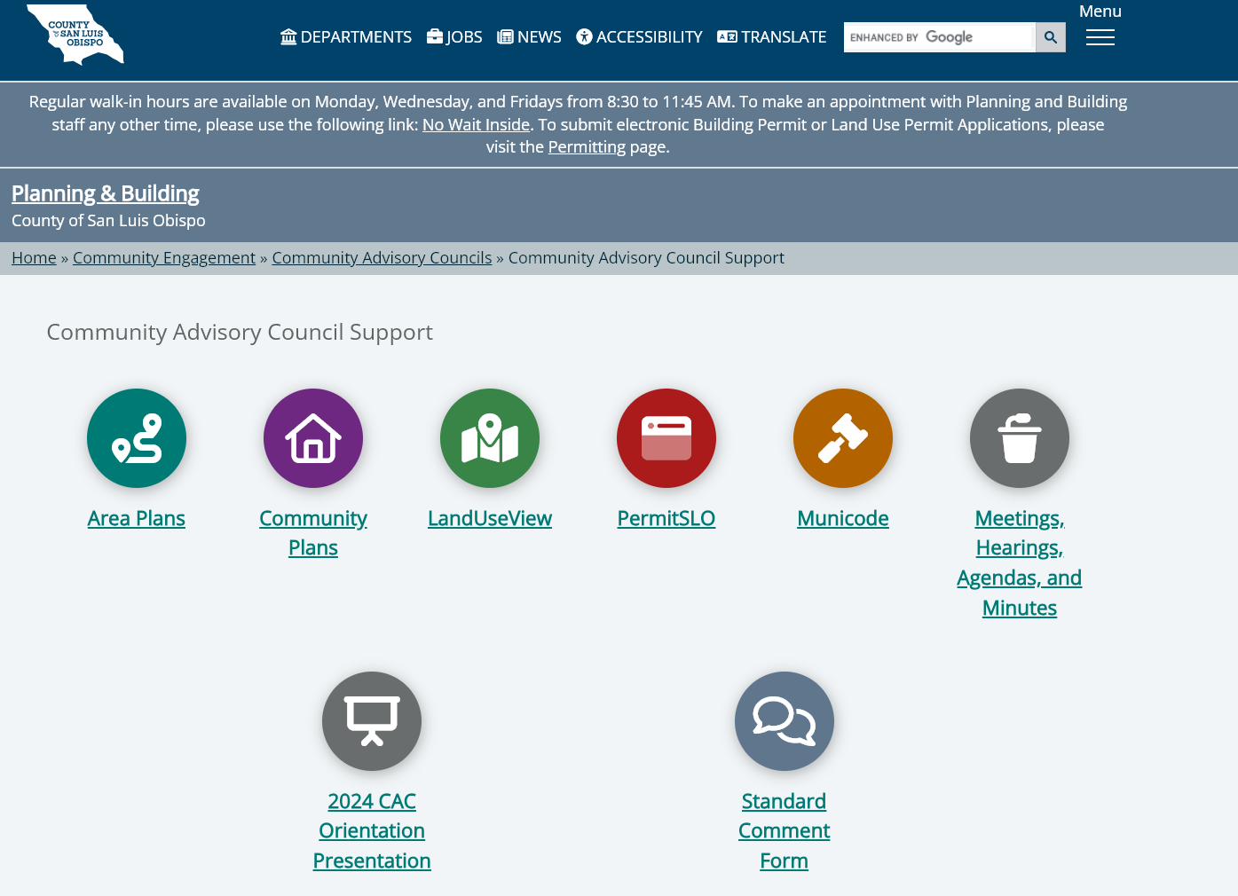

Community Advisory Council Resources
P&B

Slide 61

Thank you!
Thank you for Attending and Participating!

