Slide 1
HMIS Office Hours
12/6/2023

Slide 2
Presenters
Name
Contact Information
Abby Burgess
Project Manager
ICA
Kate Bourne
Business Systems Analyst
Department of Social Services
Homeless Services Division
Kari Howell
Program Manager
Department of Social Services
Homeless Services Division
Staci Dewitt
Program Review Specialist
Department of Social Services
Homeless Services Division
Email: ss_hmissupport@co.slo.ca.us
Your Voice Matters! Have Questions or Concerns for us? Scan this QR code and submit it.

Slide 3
Agenda
Review of Data Quality Issues and Impact for Bell Data to Clarity Migration
Workflows to Correct Data Quality Issues in Bell Data
Next Steps and Timeline

Slide 4
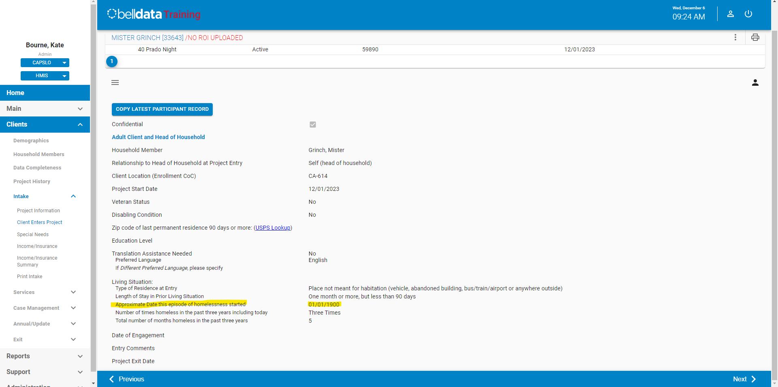
Data Quality Review
Issue | Impact | Correction
3.917 Homeless History/ Approximate Date Started | Inaccurate LOT Homeless Impacts HUD CSV Migration- Records are pulling as blank in the HUD CSV file and will be migrated as blank (null). Impacts HUD System Performance Measures | Update Date Homelessness Started to accurate date May use enrollment date if no other data is available for first time homeless Date must be consistent with other 3.917 fields
Notes:
Add in the risk of CES Data Migration

Slide 5
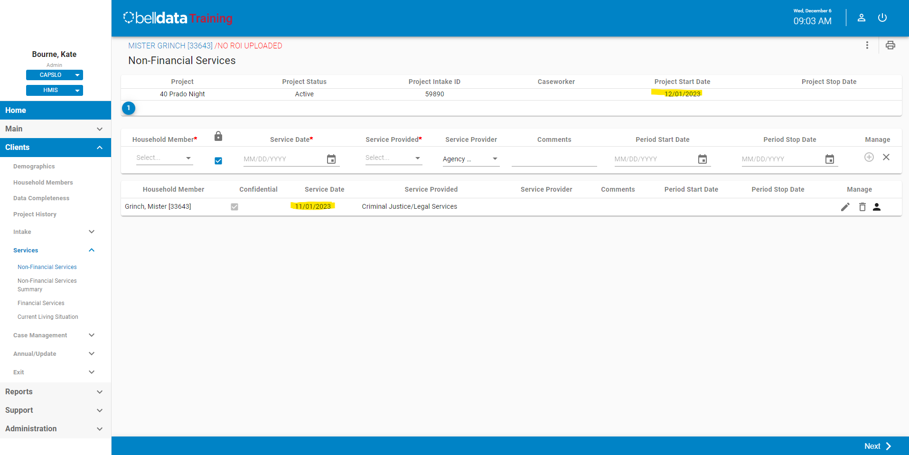
Data Quality Review
Issue | Impact | Correction
Services Outside of Enrollments | Loss of data that should be a separate and distinct enrollment for a client Impacts HUD CSV Migration for Bed Nights Possible impacts to CoC APR and/ or ESG CAPER, if applicable to funding source. Data Standard Reference: There must be a record of a bed night on the project start date into the shelter; any additional bed night dates must be after the Project Start Date and before the Project Exit Date. | Delete erroneous records Create distinct enrollments, if necessary Edit enrollment or exit dates to cover service ranges
Notes:
Add in the risk of CES Data Migration

Slide 6
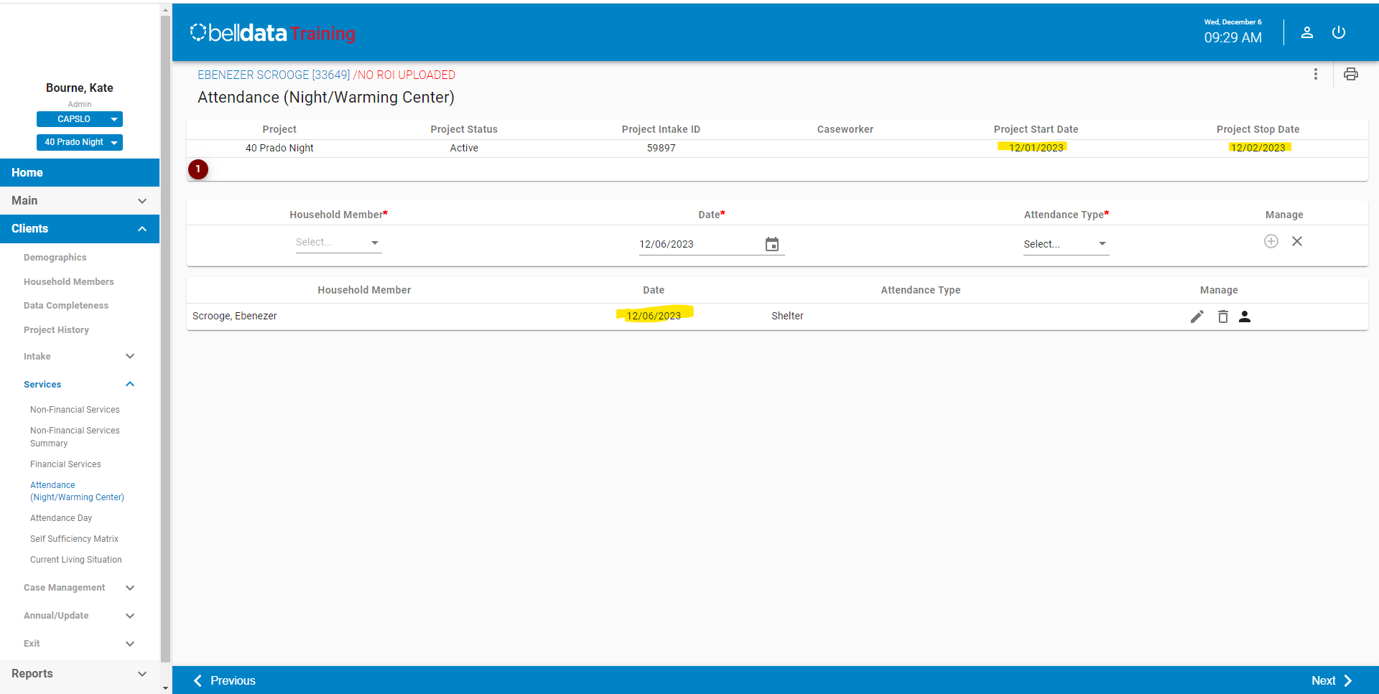
Data Quality Review
Issue
Services Outside of Enrollments

Slide 7
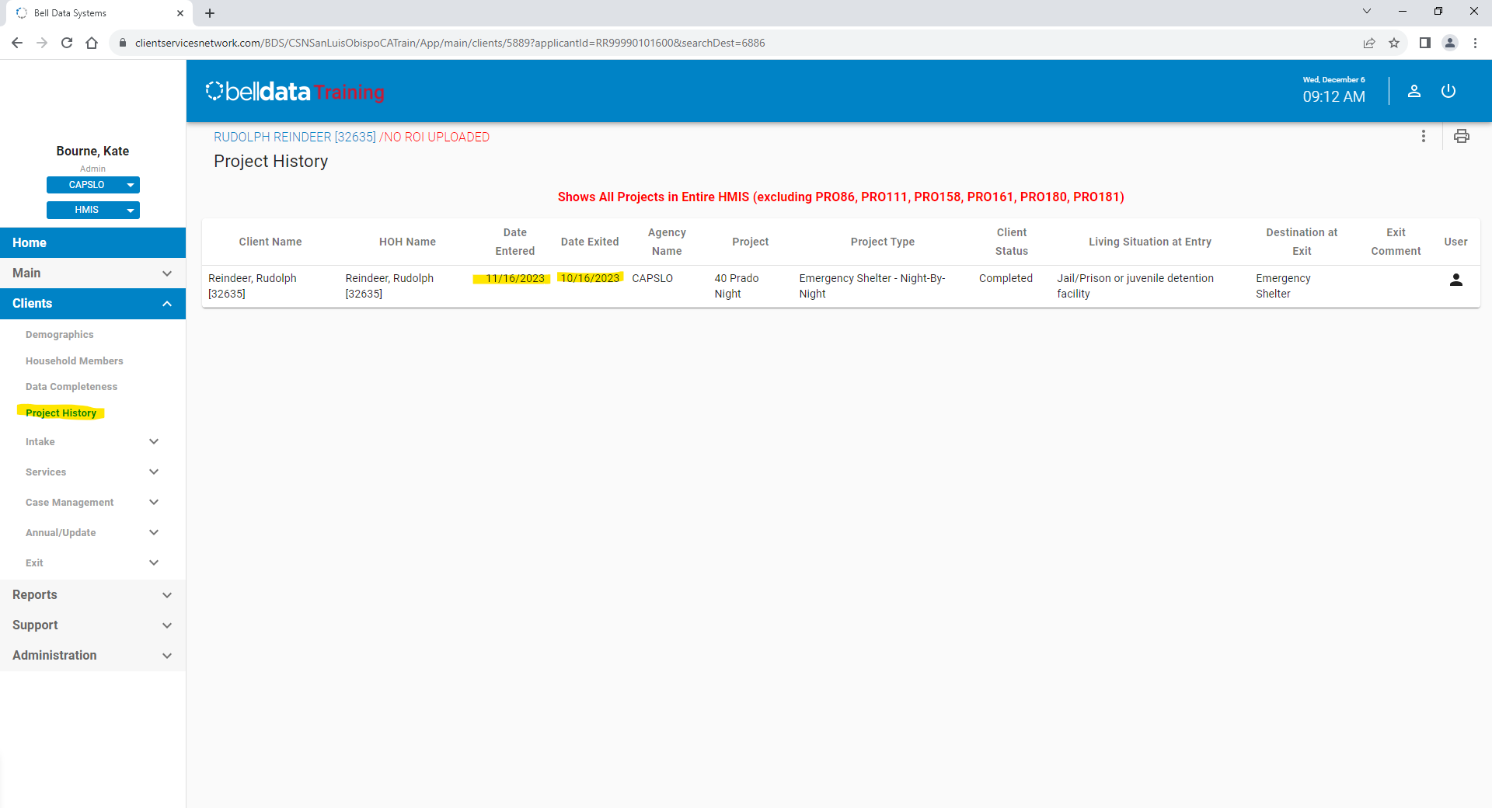
Data Quality Review
Issue | Impact | Correction
Exit Before Entry | Incorrect enrollment Impacts HUD CSV Migration Possible impacts to CoC APR and/ or ESG CAPER, if applicable to funding source | Update Exit Date to accurate date
Notes:
Add in the risk of CES Data Migration

Slide 8
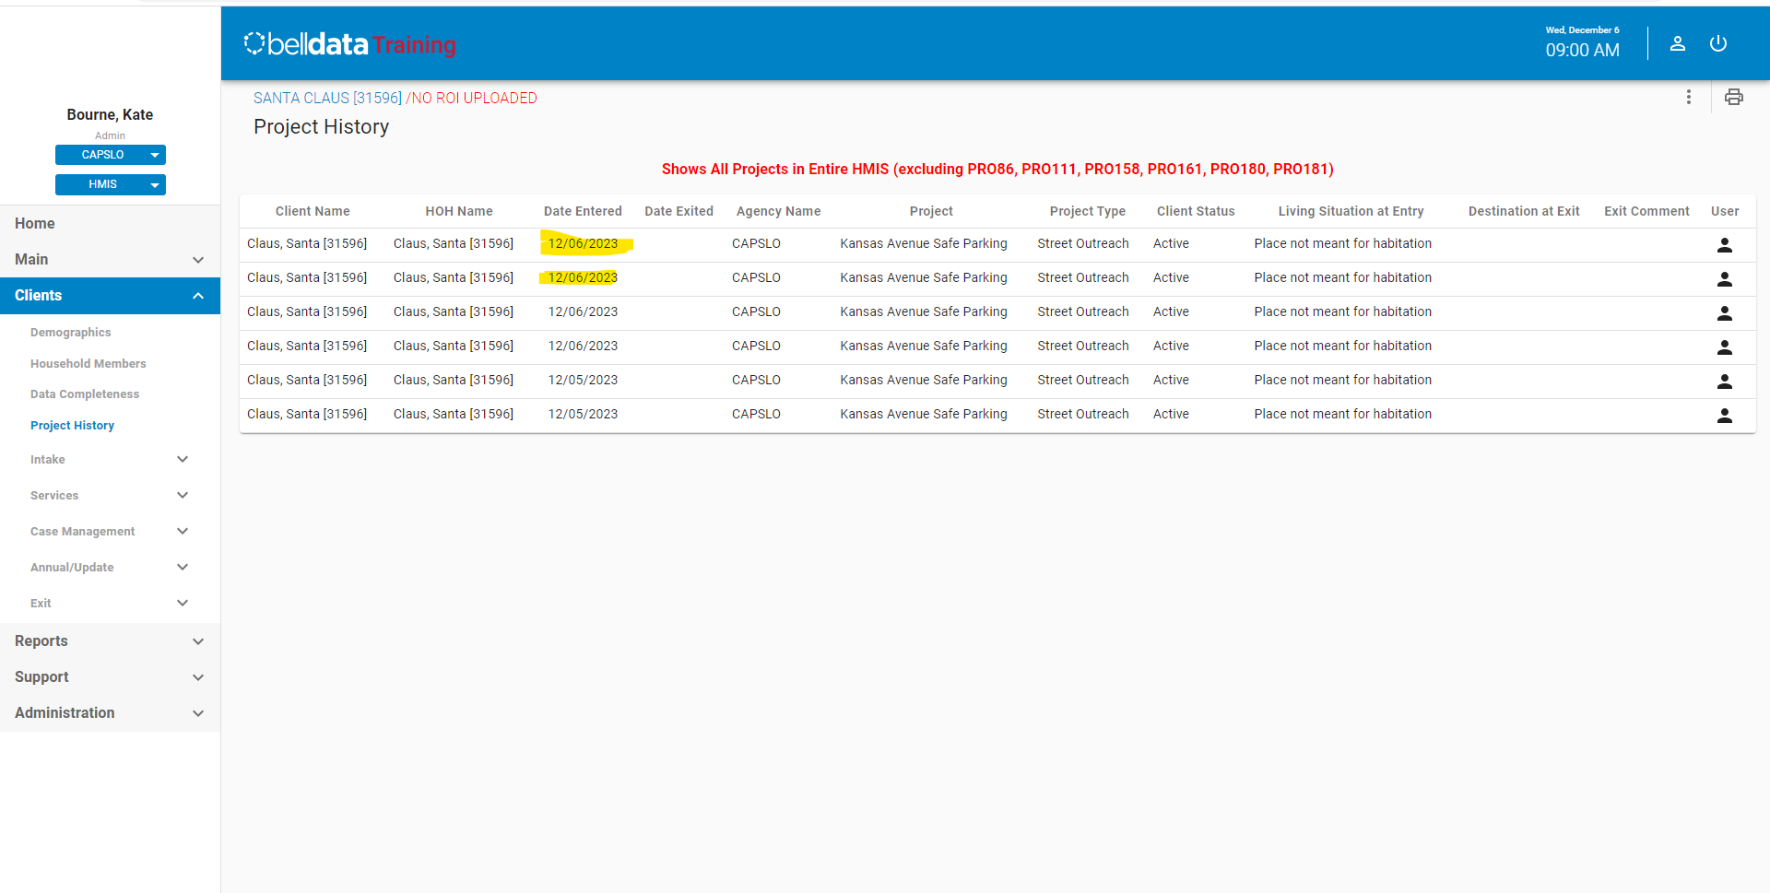
Data Quality Review
Issue | Impact | Correction
Duplicate Enrollments | Loss of data that should be a separate and distinct enrollment for a client Impacts HUD CSV Migration Possible impacts to CoC APR and/ or ESG CAPER, if applicable to funding source | Delete erroneous records Create distinct enrollments, if necessary
Notes:
Add in the risk of CES Data Migration

Slide 9
Data Quality Review
Issue | Impact | Correction
Duplicate Enrollments | Loss of data that should be a separate and distinct enrollment for a client Impacts HUD CSV Migration Possible impacts to CoC APR and/ or ESG CAPER, if applicable to funding source | Delete erroneous records Create distinct enrollments, if necessary
Notes:
Add in the risk of CES Data Migration

Slide 10
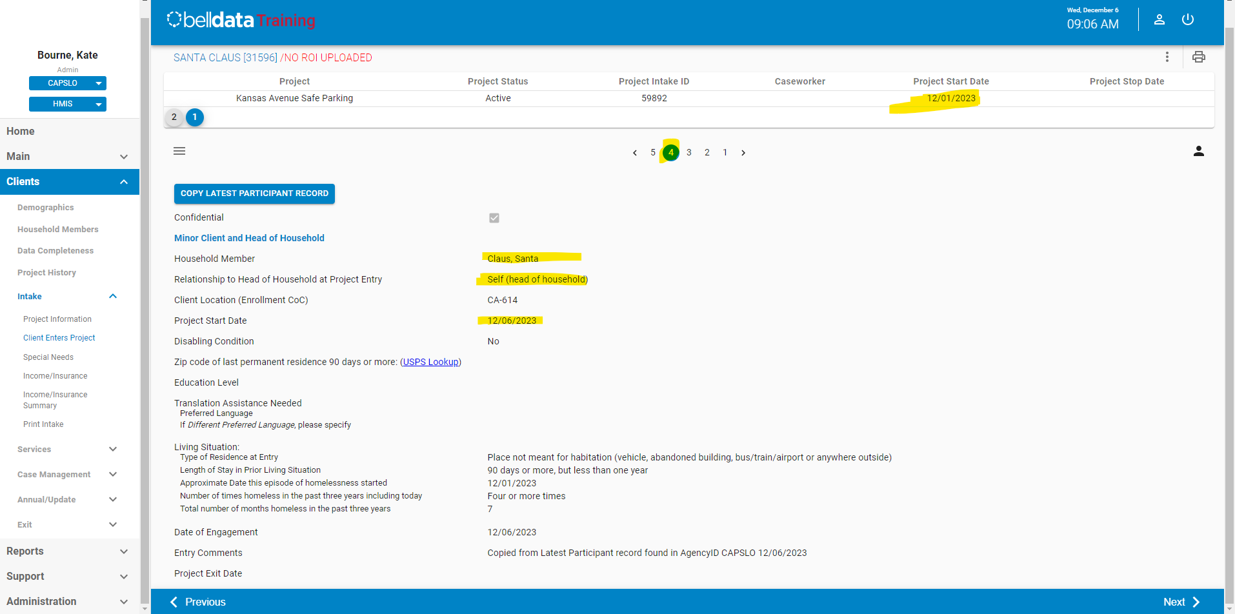
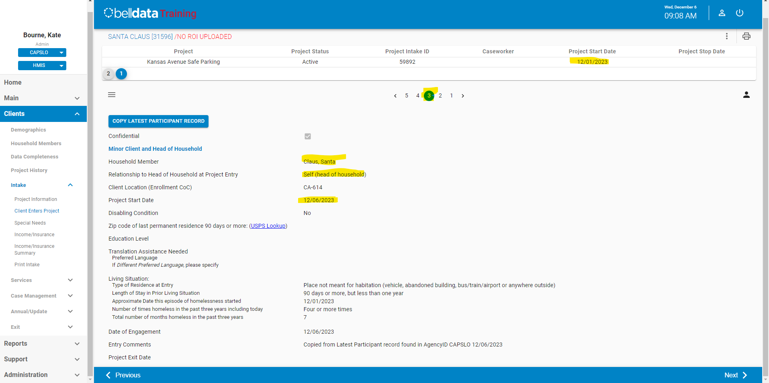
Data Quality Review
Issue | Impact | Correction
Enrollment Configuration Issues | Loss of data that should be attached to a different household member Loss of data that should be a separate and distinct enrollment for a client Impacts HUD CSV Migration Possible impacts to CoC APR and/ or ESG CAPER, if applicable to funding source | Delete erroneous records Create distinct enrollments, if necessary Edit records to include correct household members
Notes:
Add in the risk of CES Data Migration

Slide 11
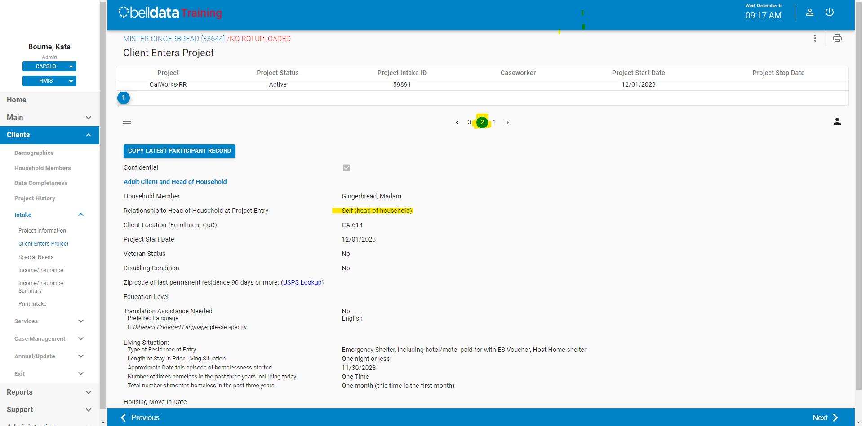
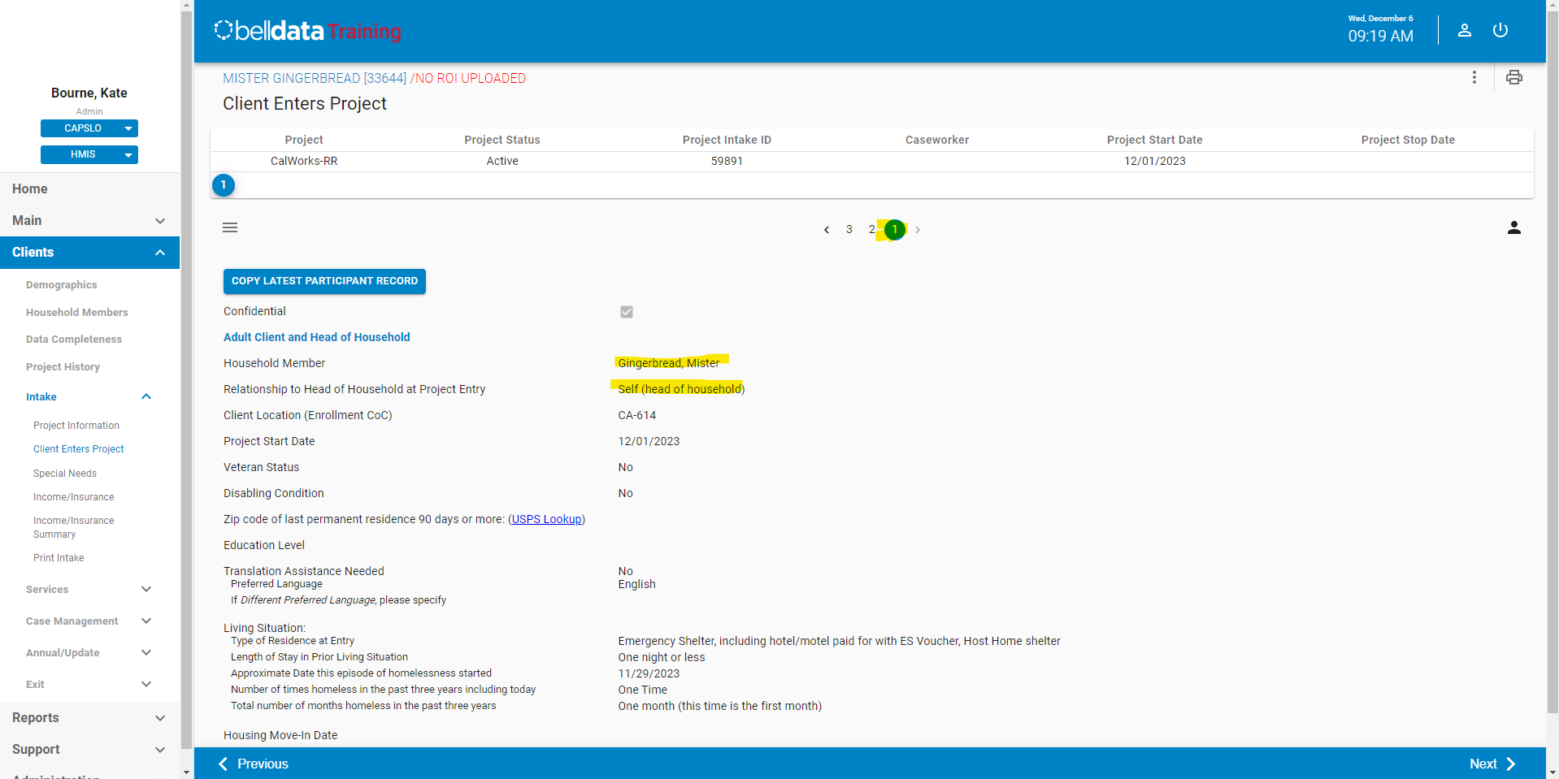
Data Quality Review
Issue | Impact | Correction
Head of Household Issues | Inaccurate household configuration Scripting will identify oldest member as Self Scripting will use MIN enrollment ID as Self if DOB issues also exist. | Correct Relationship to Head of Household in enrollment
Notes:
Add in the risk of CES Data Migration

Slide 12
Data Quality Review
Issue | Impact | Correction
Current Living Situation Updates (contacts)- Is client going to have to leave their current living situation within 14 days? (Response options 17, 37) | Inaccurate Homeless History Impacts HUD CSV Migration- Records are pulling as "Data Not Collected" in the HUD CSV file and will be migrated as blank (null). Impacts homelessness prevention data evaluation. | Review prior living situation to ensure data collected is accurate. Ensure dependent fields are updated. Note data standards changes
Notes:
Add in the risk of CES Data Migration

Slide 13
Next Steps
Review DQ files and Data Quality Issues
Correct data in Bell Data by 01/31/2024
Validate data in migration, January – February 2024
Notes:
Add in the risk of CES Data Migration

Slide 14
Next Steps

